Slide 1
ORV3 Power Shelf
Development Update (Liteon)

Slide 2


ORV3 Power Shelf Development Update
Lam Vu, Director of Engineering, Liteon Technologies
R&P (Rack & Power)

Slide 3
PSU Specification
Input Voltage:
  200V to 277V +/- 10%, 47Hz – 63Hz
  Max input current: 18A
  20mS hold-up time
  Power Factor:
    >0.98 @ 30% to 100% load
    > 0.95 @ 10% to 30% load
  THD: < 5% @ > 30% load
  Efficiency: 97.5% peak incl. fan loss
  Operating temperature range: 0 – 45C

Slide 4
PSU Specification
Output Voltage
  Main output: 51V +/- 0.25% setpoint
  3000W
  Dynamic Response: +/- 1V in addition to droop voltage
  Current Share: < 3% @ load > 40%
    Voltage droop: 0.5V over full load current
    Active current share
  Output isolated from chassis ground
No aux. output
Communication:
  PMBus on I2C hardware
  Modbus RS-485

Slide 5
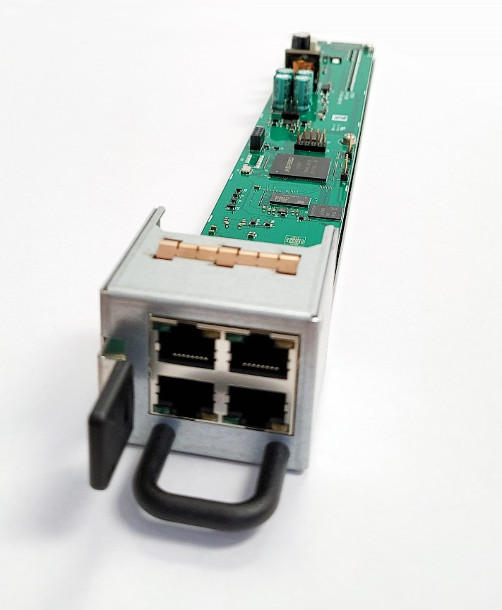
PMC Specification
Communicate with PSU via I2C or Modbus
Communicate with Rack Management System
  Web Interface
    HTTP/HTTPS RESTful API
    Redfish v1
    SNMP v3
    IPMI BMC
  Modbus (RS485/TCP)
  Remote FW Upgrade (PSC/PSU)

Slide 6
ORV3 PSU Models at Liteon
Liteon develops a whole range of power supply module under ORV3 specification
PSU for 21” rack application:
  3kW in 520mm length
  5kW in 520mm length
  5.5kW in 640mm length
PSU for 19” rack application:
  3kW in 68mm width, 520mm length
  39mm height to fit into 1RU power shelf
  Shelf controller (PMC) mounted in rear of power shelf

Slide 7
ORV3 Power Shelves at Liteon
Liteon can customize shelf configuration using ORV3 power supply for different application:
  Single or dual AC inputs: 208V ∆, 240V ∆, 415V Y, 480V Y
  OU height 21” OCP power shelf
  RU height 19” power shelf
  Shelf with auxiliary C13s for TOR components
  Shelf with daisy chain signal connector for parallel between shelves
  Immersion liquid cool power shelf with front access

Slide 8

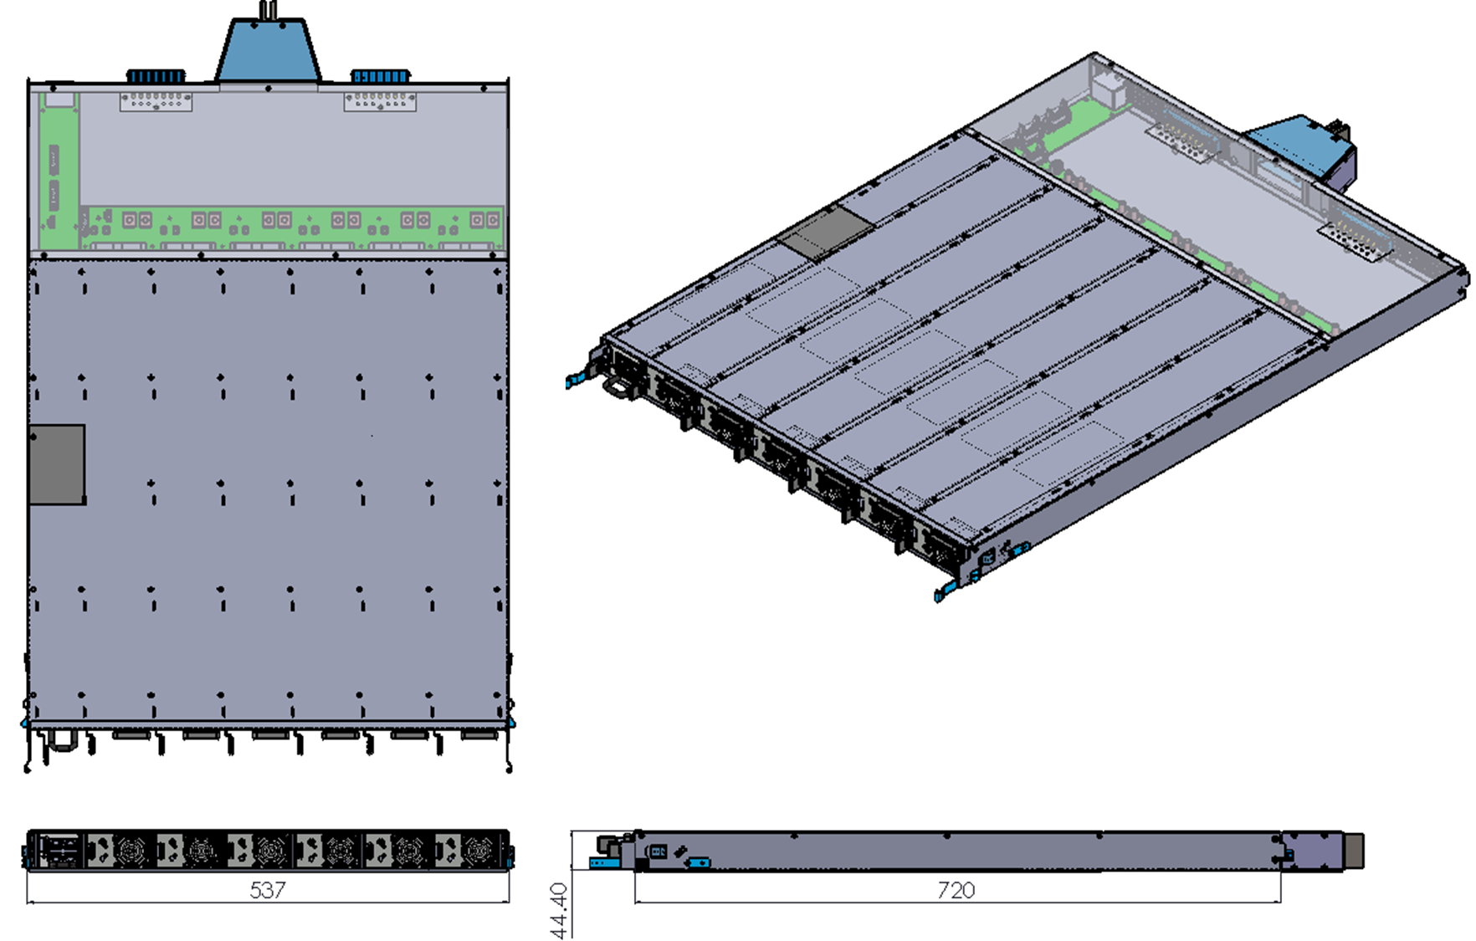
1OU Power Shelf

Slide 9
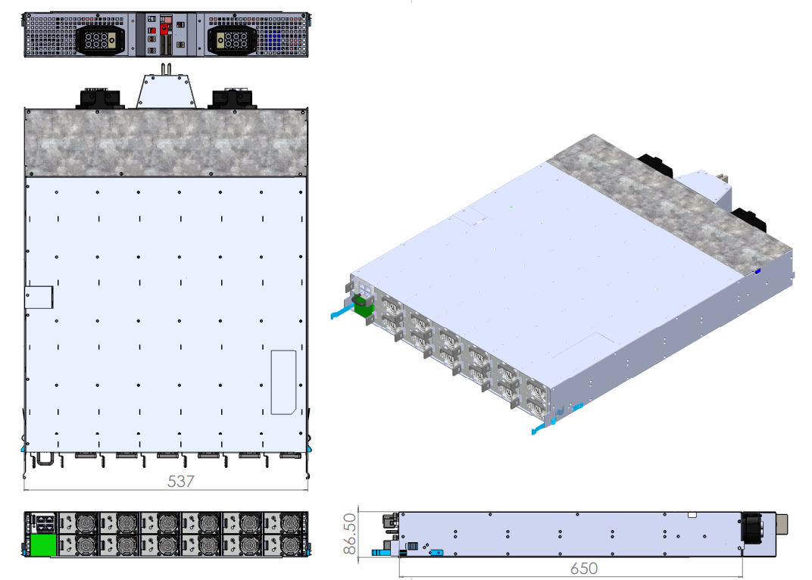
2OU Power Shelf

Slide 10
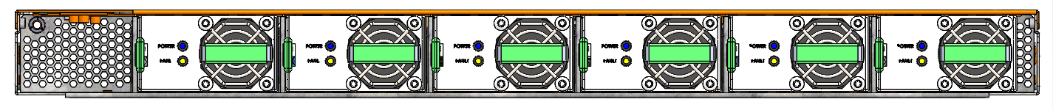
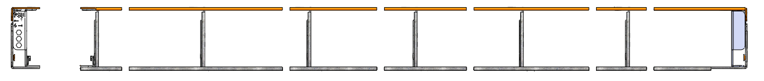
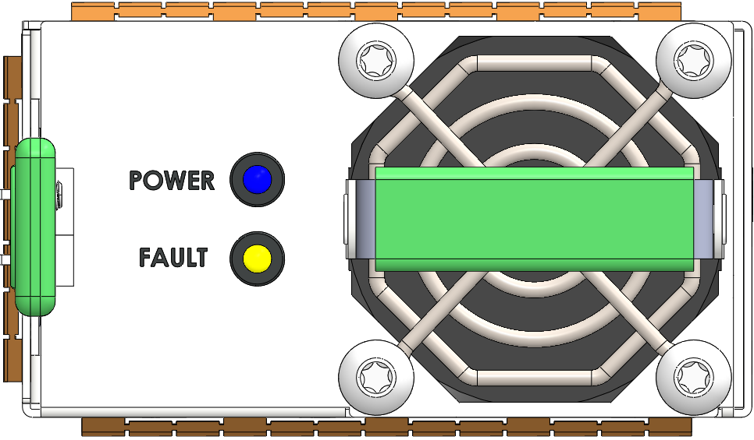
1RU Power Shelf
PSU |  |  |  | Shelf |  |  | Case sheet metal thickness
Length | Width | Height | Slot quantity | Length | Width | Height | Case-btm | Case-top | Partition
520 | 68 | 39.55 | 6 | 727 | 445 | 43.65 | 1.2 | 1 | 1
PSC width
21.6

Slide 11
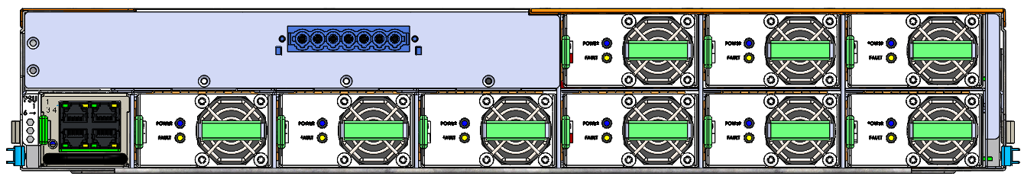
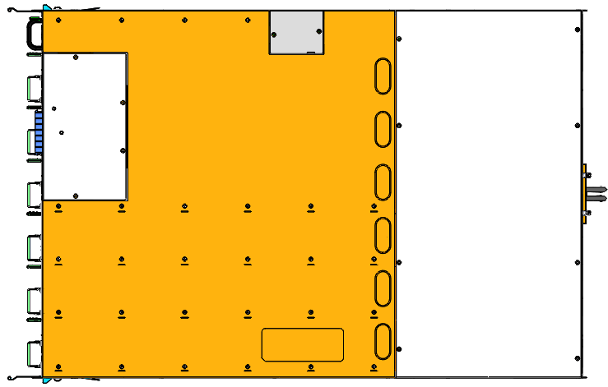
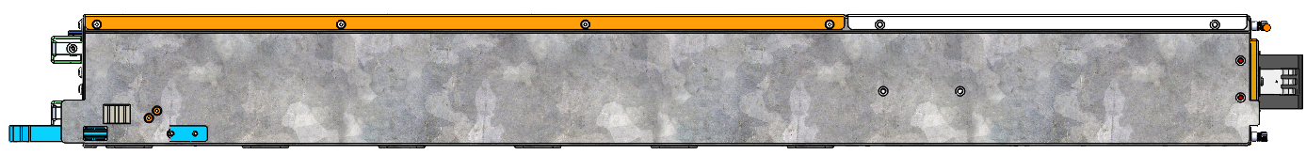
Immersion Application Power Shelf: All Front Access

Slide 12
BBU Specification
Battery string:
  Murata VCT4, 11S6P
  Capacity: 4 minutes at the end of 4 years, 35C ambient
  Voltage range: 33V – 44V
  Max charging current: 5A (3hr charging time)
  > 10 days between recharge (self discharge)
  BBU life: 8 years

Slide 13
BBU Specification
Output Voltage
  Main output: 48V +/- 0.25% setpoint
  3000W
  Efficiency:
    44V input: 99% pk, 98.4% full load
    34V input: 98.7% pk, 97.3% full load
  Dynamic Response: +/- 1V in addition to droop voltage
  Current Share: < 3% @ load > 40%
    Voltage droop: 1V over full load current
    Active current share
  Output isolated from chassis ground

Slide 14
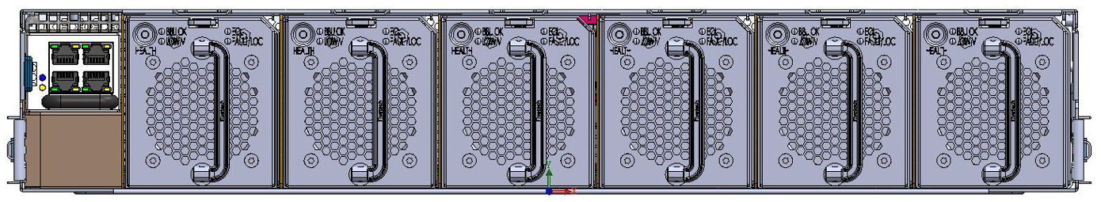
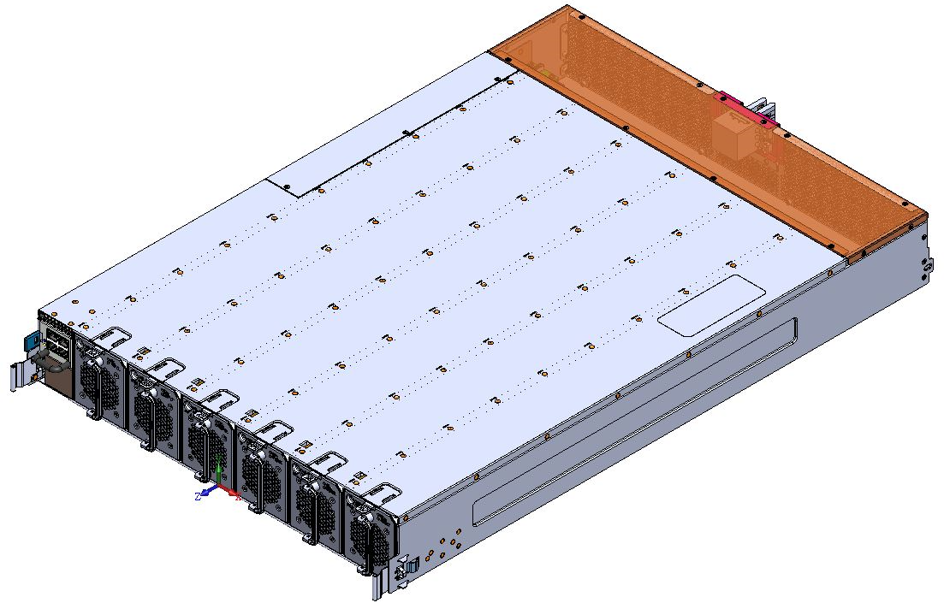
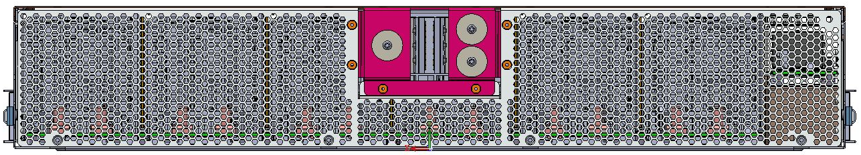
BBU Shelf

Slide 15
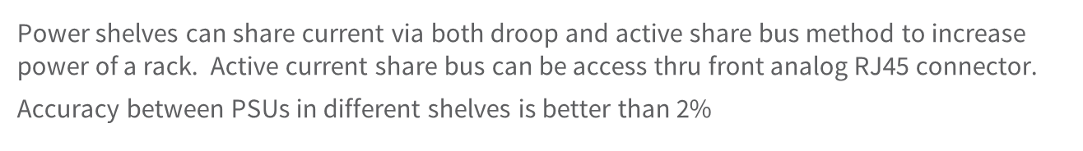
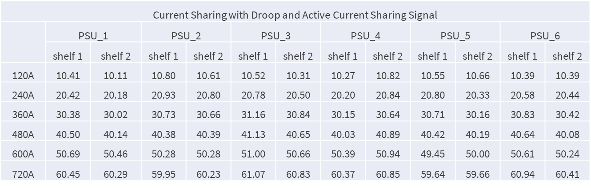
More Power in a Rack: Current Sharing Between Power Shelves

Slide 16
More Power in a Rack: Current Sharing with Droop Only
  Without active current share signal, two power shelves can share thru droop with more error between two shelves: < 10%
Current Sharing with Droop Only
 | PSU_1 |  | PSU_2 |  | PSU_3 |  | PSU_4 |  | PSU_5 |  | PSU_6
 | shelf 1 | shelf 2 | shelf 1 | shelf 2 | shelf 1 | shelf 2 | shelf 1 | shelf 2 | shelf 1 | shelf 2 | shelf 1 | shelf 2
120A | 9.31 | 11.56 | 9.35 | 12.27 | 9.79 | 8.19 | 8.33 | 11.73 | 8.18 | 11.61 | 7.87 | 11.27
240A | 18.79 | 21.47 | 19.37 | 21.99 | 19.79 | 18.27 | 18.06 | 21.59 | 18.72 | 21.46 | 17.61 | 21.22
360A | 28.91 | 31.53 | 29.25 | 31.97 | 30.36 | 28.68 | 27.79 | 31.72 | 28.42 | 31.40 | 27.96 | 31.61
480A | 38.77 | 41.39 | 38.58 | 41.56 | 40.20 | 38.73 | 37.61 | 41.89 | 37.91 | 41.19 | 37.58 | 41.51
600A | 48.42 | 51.46 | 48.09 | 51.40 | 49.79 | 48.80 | 47.45 | 52.30 | 47.76 | 51.46 | 47.22 | 51.46
720A | 58.13 | 61.24 | 57.61 | 61.14 | 59.87 | 58.98 | 57.03 | 62.52 | 57.34 | 61.25 | 56.54 | 62.02

Slide 17
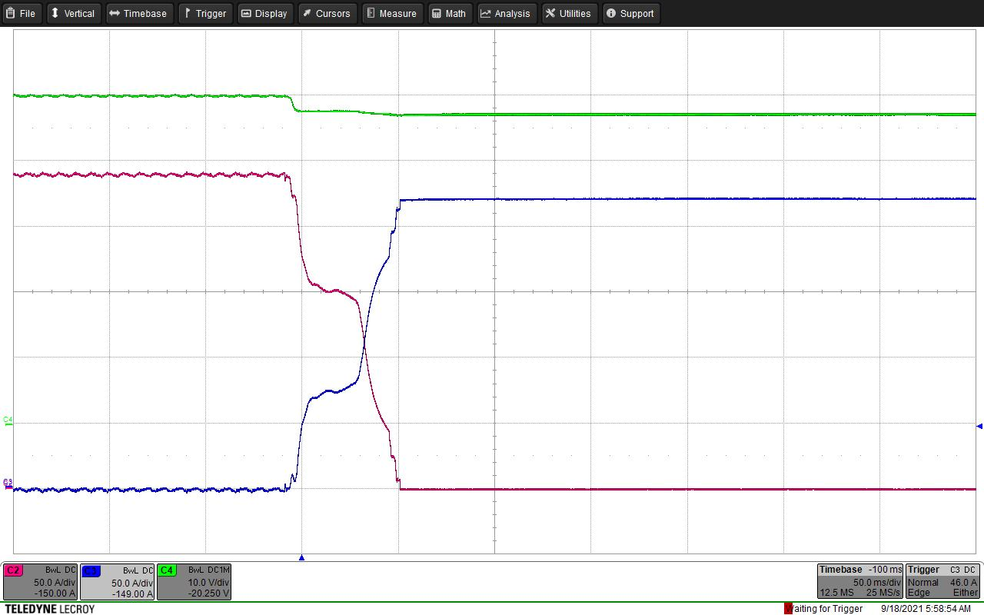
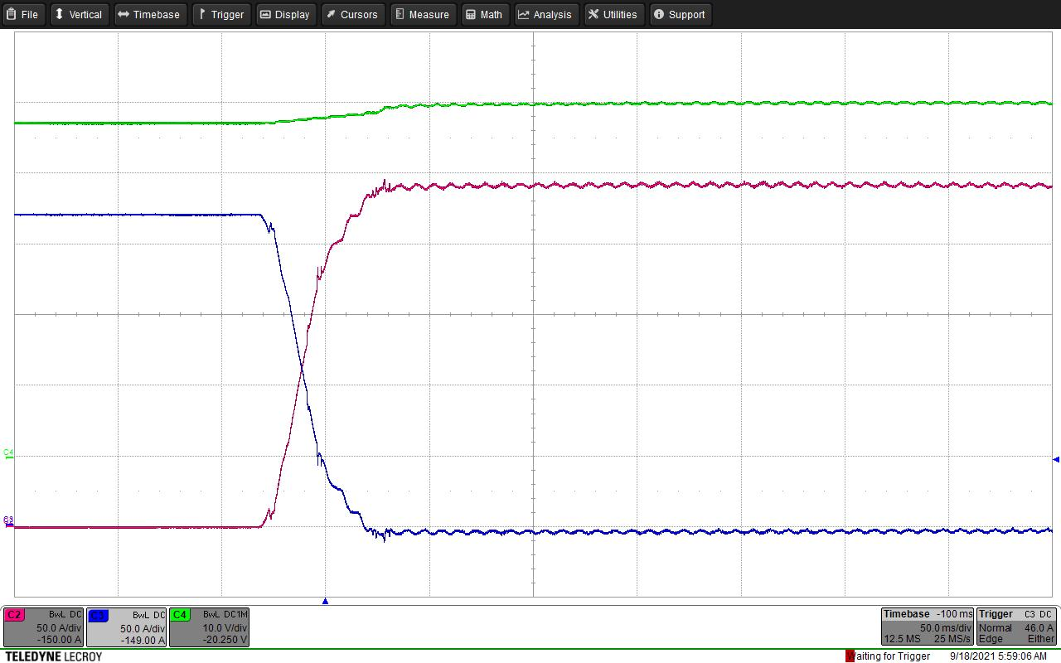
Power Transition Between ORV3 PSU Power Shelf and BBS
Line Loss
Power Shelf to Battery Shelf
Battery Shelf to Power Shelf
Power Shelf Curr
50A/div
Holdup time
50mS/div
Battery Shelf Curr
Power Shelf drops output 3V to trigger Battery shelf to start providing power
Power shelf and battery shelf share current by droop mode during transition time

Slide 18
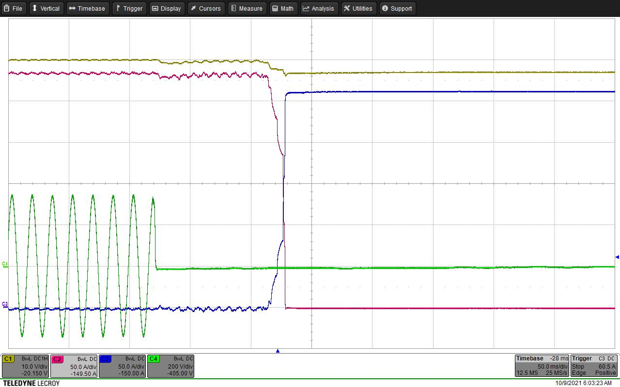
ORV3 Rectifier to BBU Transitions in Fault Cases
At the end of overload duration, PSUs lower output by 3 V to signal transferring load to Battery Backup
120% overload on the remaining 4 PSUs
Battery Shelf supports load
One Line of 3-phases fails causing loss of 2 PSUs

Slide 19
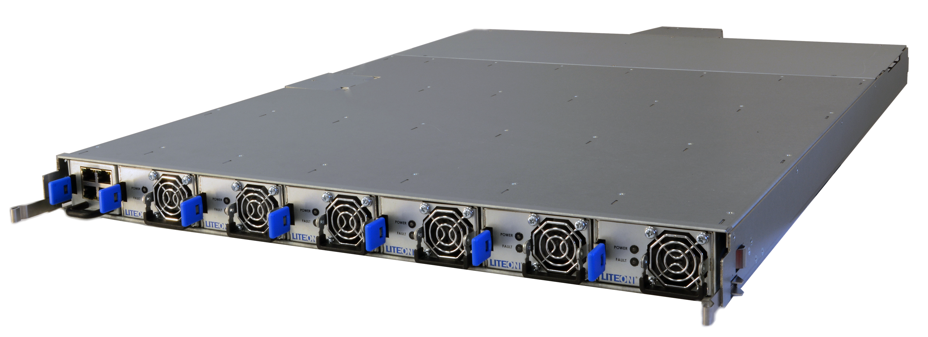
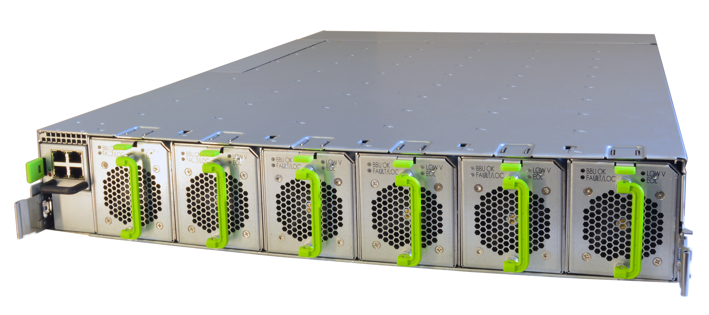
For more information & Prototypes
Contact: jason.yang@liteon.com

Slide 20

Call to Action
RACK & POWER
Get in touch with us to receive latest information about the ORV3 power shelves
Start testing the ORV3 Power Shelves by yourself! Samples available!
Give feedback of your findings to help improving the project in future

Slide 21
Thank you!

