Slide 1
Rack and Power ORV3 Busbars
Mike Wingard – Amphenol
Dmitriy Shapiro - Meta

Slide 2
Comparison of ORV2 to ORV3 Busbars
ORV2
Fixed connection from the Power Shelf to the Busbar
Two power zones, each with a dedicated power shelf location
12V and 48V busbar options
By design, does not meet the “Touch Proof” requirement in UL 60950 (updated to UL 62368-1)
Busbar enclosure may be electrically floating
Allows a gatherability tolerance of ± 2mm
ORV3
Flexible connection locations from the Power Shelf to the Busbar via a Power Connector
One power zone, allowing for placement flexibility
48V only busbar option
Meets the “Touch Proof” requirement (adult finger probe) in UL 62368-1
Busbar enclosure is part of the Chassis Ground connection
Allows a gatherability tolerance of ± 3mm

Slide 3
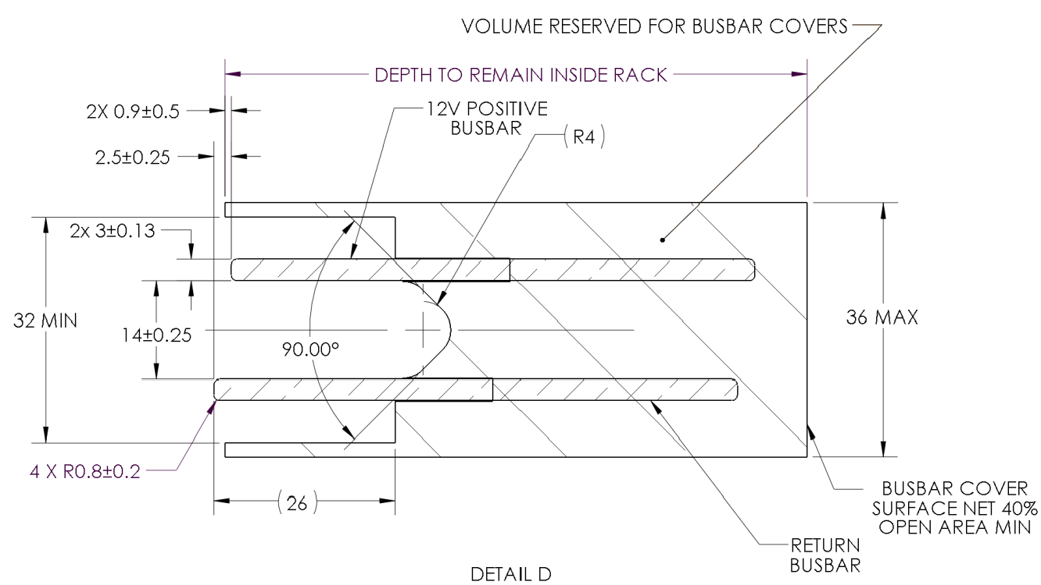
ORV2 Spec
12V

Slide 4
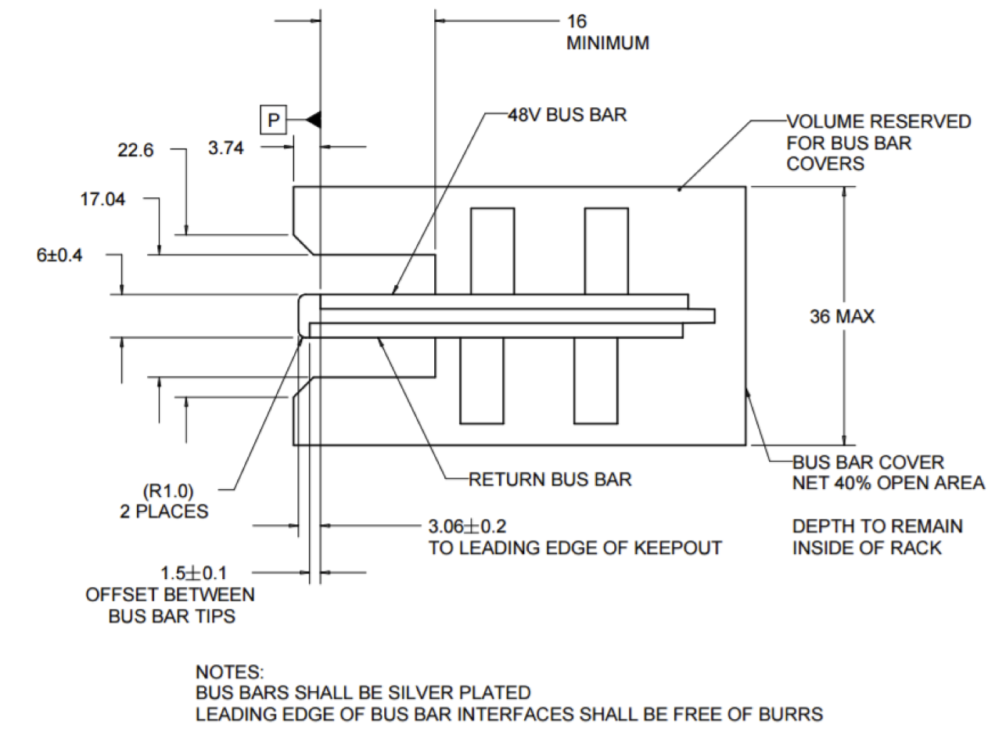
ORV2 Spec
48V

Slide 5
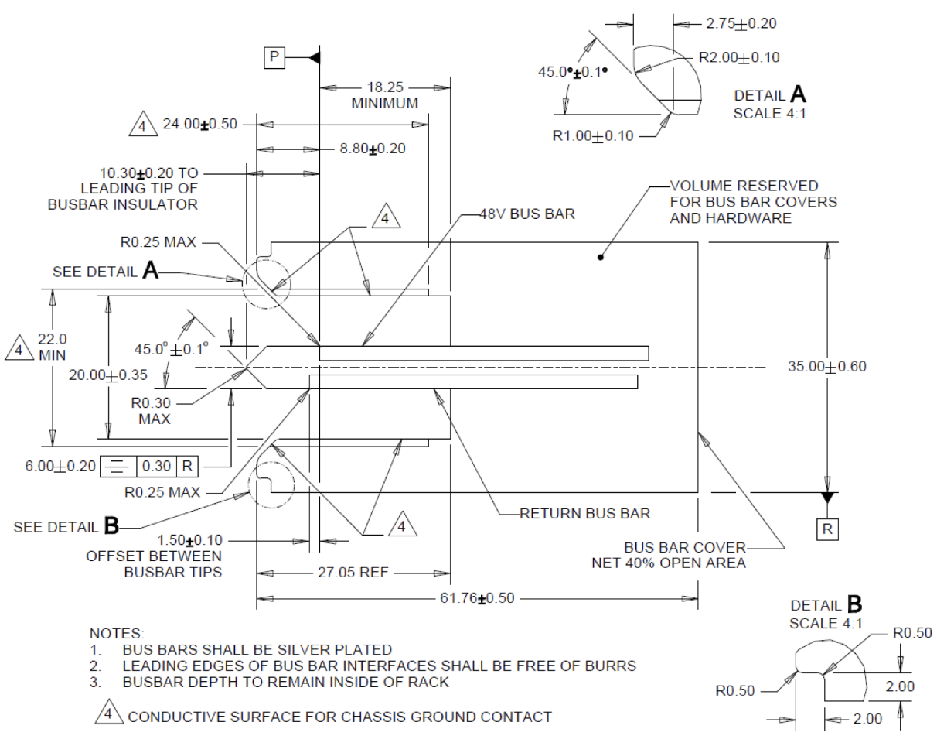
ORV3 Spec

Slide 6
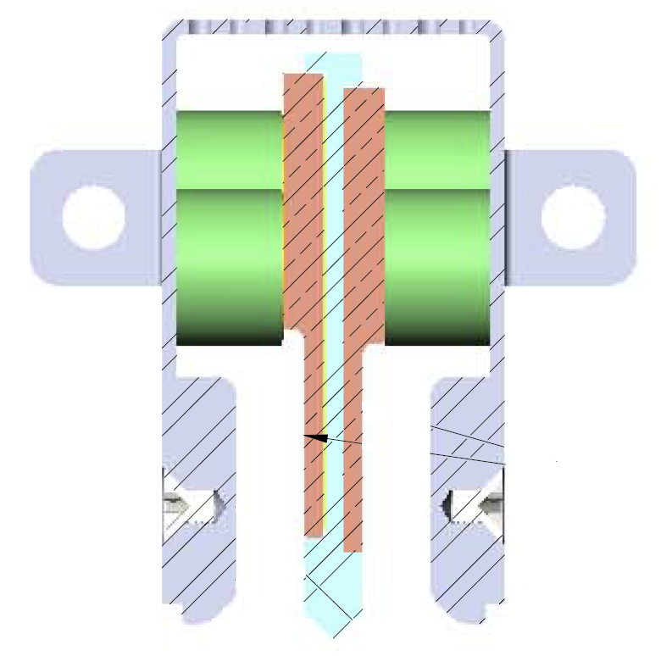
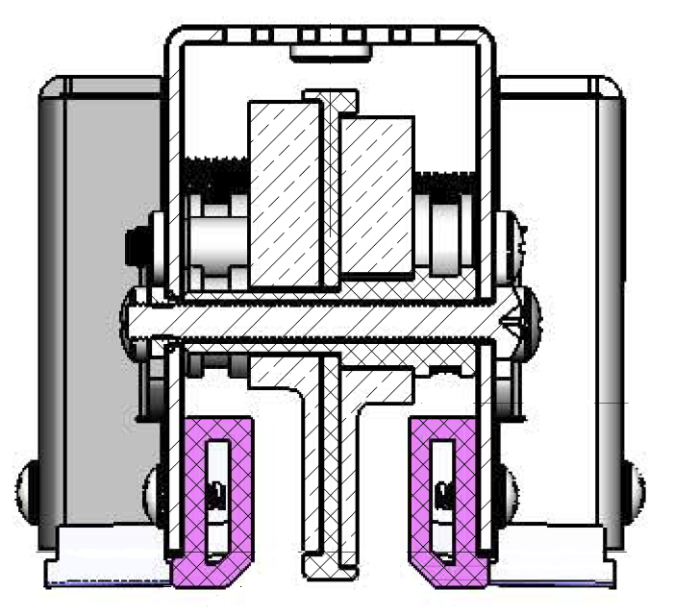
Comparison of 48V ORV2 to ORV3
ORV2
ORV3
Chassis Ground
Connection to
the Rack
Busbar is
“Touch Proof”
Conductive
Guides
Clearance for
connector
mounting screw
Cover around the
Power Shelf Connection
(Threaded Studs)
Improved Gatherability
Non-Conductive Guides
Busbar is not
“Touch Proof”

Slide 7
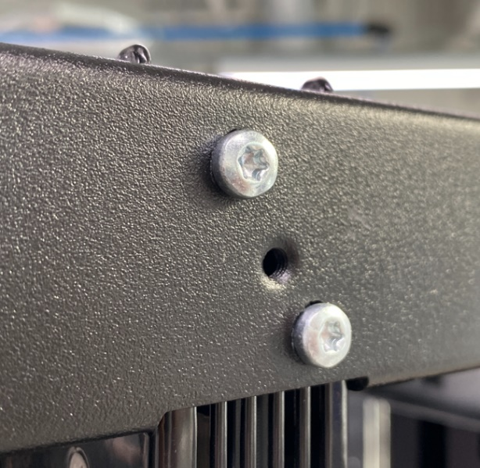
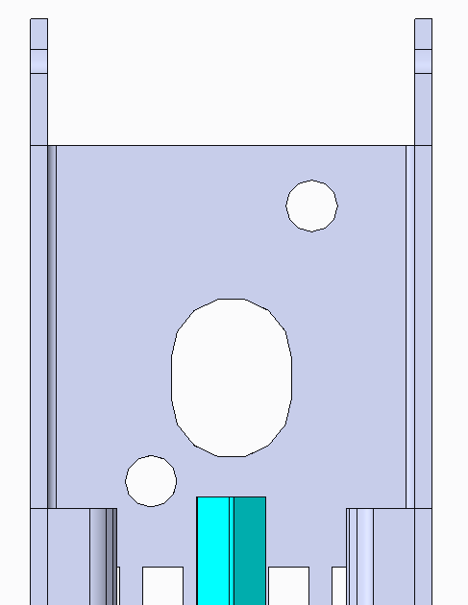
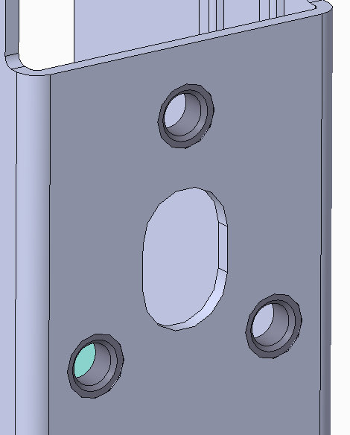
Recent ORV3 Design Improvements
Redesigned top-side mounting from 2x thread forming screws to 3x machine screws going into PEM nuts

Slide 8
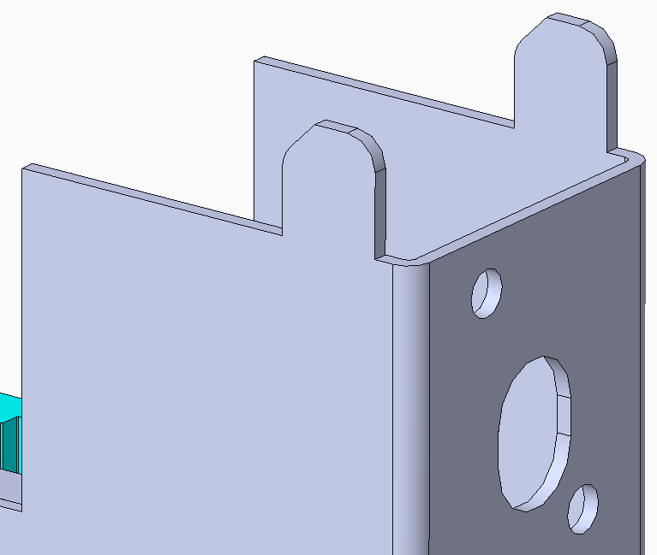
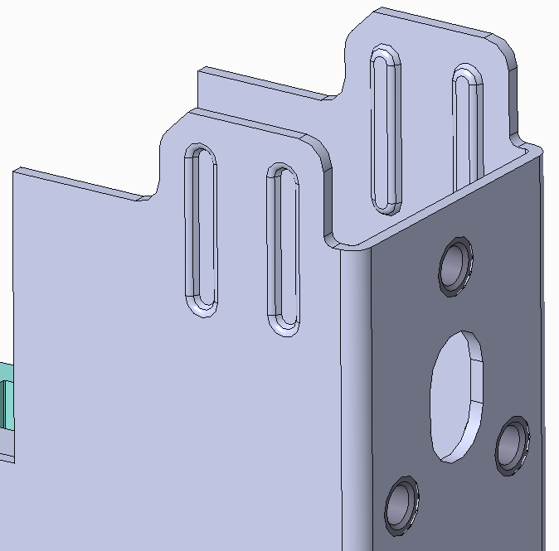
Recent ORV3 Design Improvements
Enlarged top-side alignment tabs and added embosses for stiffness

Slide 9
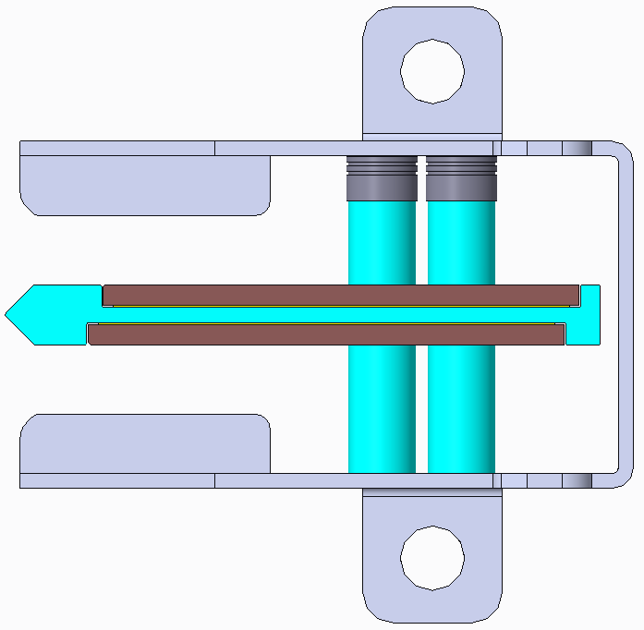
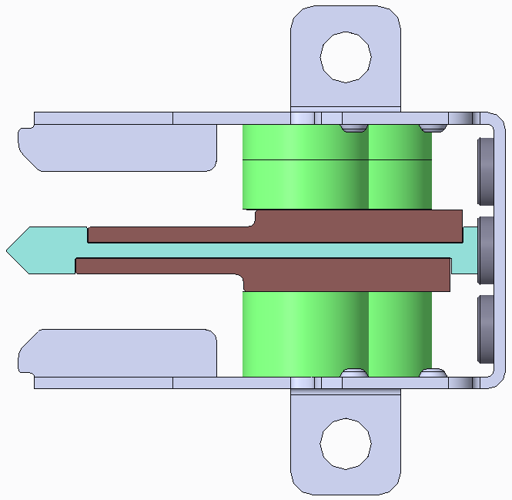
Recent ORV3 Design Improvements
Larger opening for improved connector gatherability
Cutouts for connector mounting screw clearance
Enlarged busbar support for extra stiffness
Optional extra copper

Slide 10
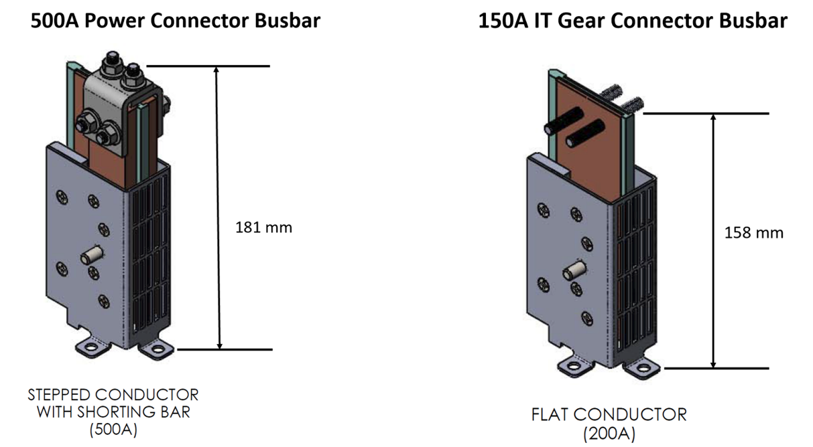
ORV3 Test Busbars
Chassis
Ground
Studs
Mounting Tabs

Slide 11
Reference OCP Rack and Power Specs
ORV2
Open Rack Standard V2.2 (September 3, 2019)
ORV3
Open Rack V3 IT Gear Input Connector V1.5 (April 2022)
Open Rack V3 Power Shelf 48V Output Connector V2.0 (April 2022)
Open Rack V3 Rack – Busbar Interface Rev J (April 2021)

