Slide 1
Rack and Power ORv3 Connectors
Steve Pressel - Amphenol
Brian Costello - TE Connectivity

Slide 2
ORv3 Power Output Connector Updates

Slide 3
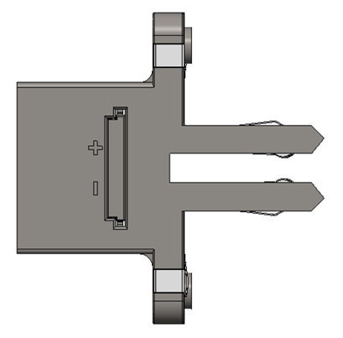
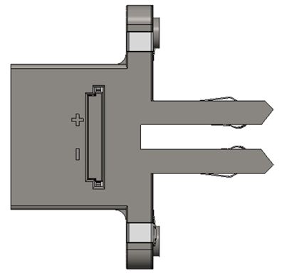
Larger opening for improved connector gatherability
Larger gatherability geometry has increased connector tip length

Slide 4
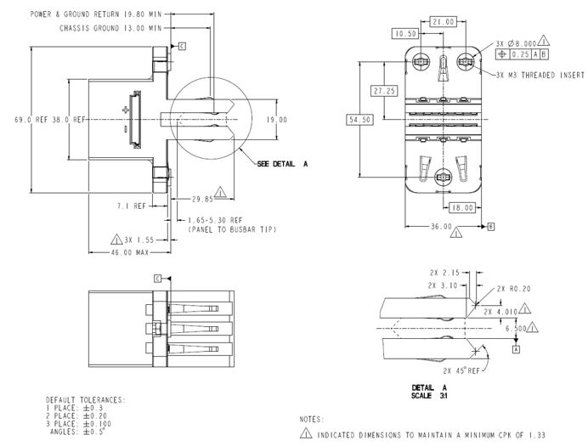
ORv3 Spec
Power contacts to be plated with silver over nickel in the busbar mating zone
Chassis ground contacts to be plated with matte tin over nickel in the busbar ground mating zone
Tolerancing and dimensioning scheme updates

Slide 5
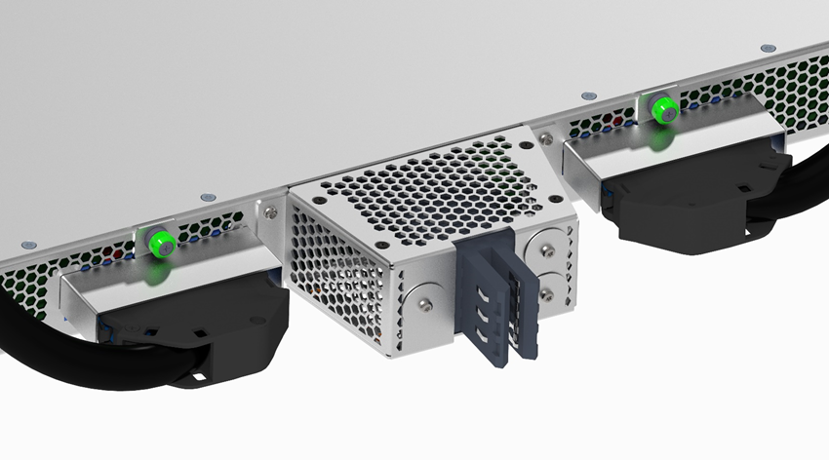
Mounting Hardware:
Fasteners: M3 screws with 6 mm MAX head diameter and 2.5 mm MAX head height.
Washers: 20 mm diameter and 1+0.5/-0 mm thickness (improvement from previous 0.5mm)

Slide 6
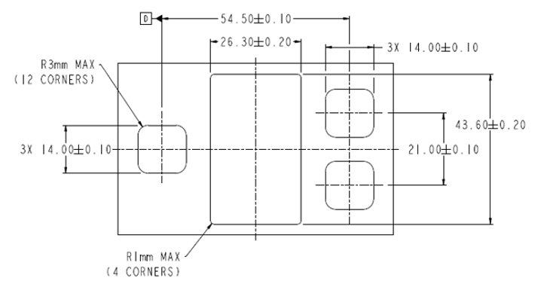
Screw Mounted Connector
Added Datum -D- to Panel Cutout
Reduced cutout width/height from 14.2 to 14.0

Slide 7
ORv3 IT Gear Connector Update
Review ORv3 Changes to Screw Mount Design
Review Toolless Connector Design
Review Toolless Connector Panel Cutout

Slide 8
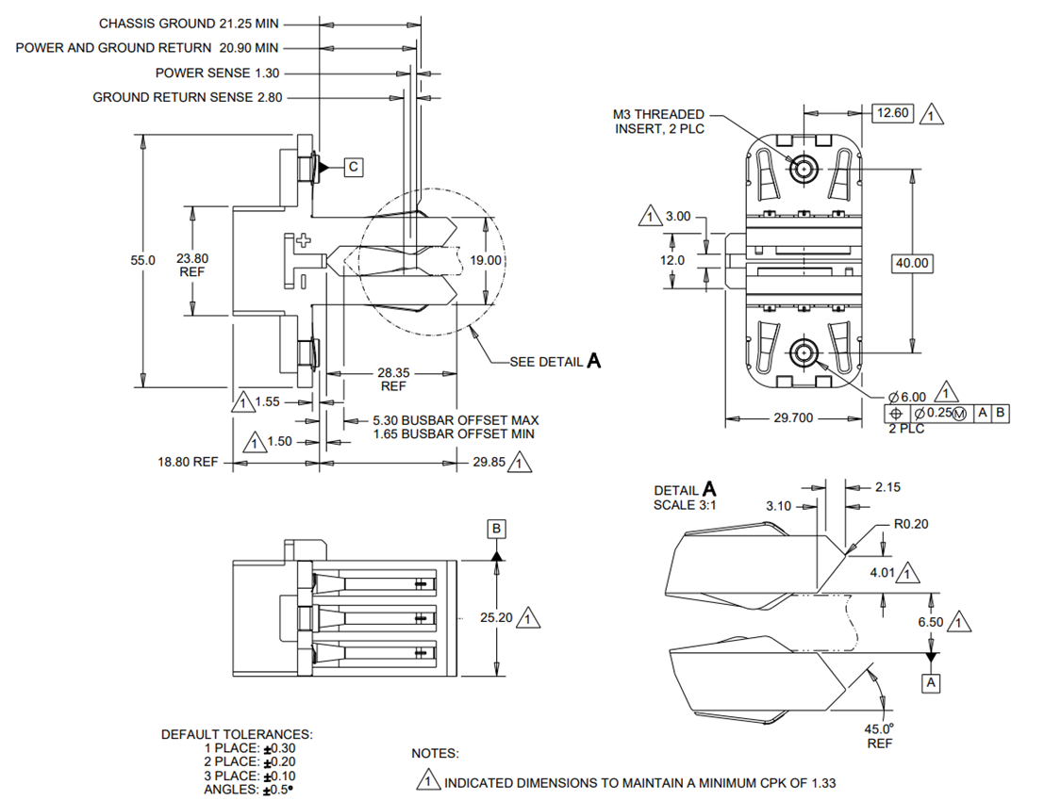
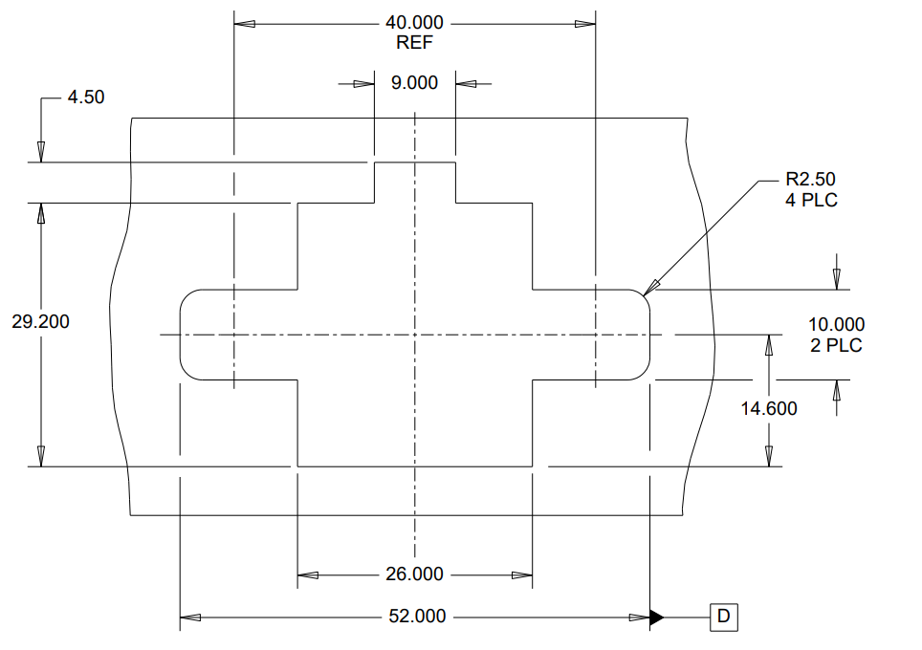
Screw Mount Design
Added Datum -D- to Panel Cutout
Implemented same changes to gatherability and dimensioning as on power connector

Slide 9
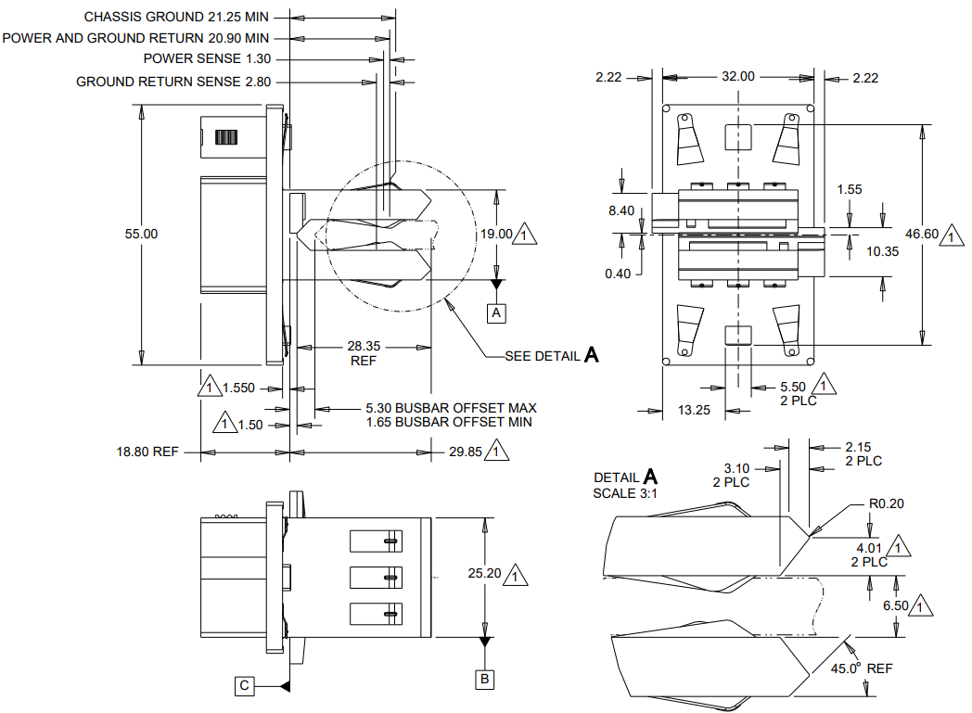
Tooless Design
Reduced Connector Width to match size of screw mount design
Reduced locking feature height to prevent panel ground contact stubbing
Adjusted Panel Cutout to match connector changes
Added Datum -D- to
Panel Cutout

Slide 10
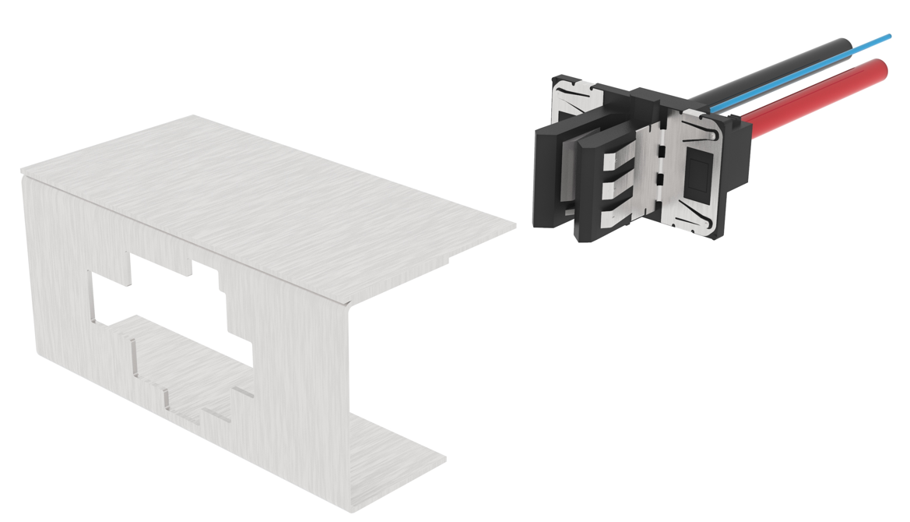
Tooless Design: Assembly
Connector prior to being assembled
to the panel

Slide 11
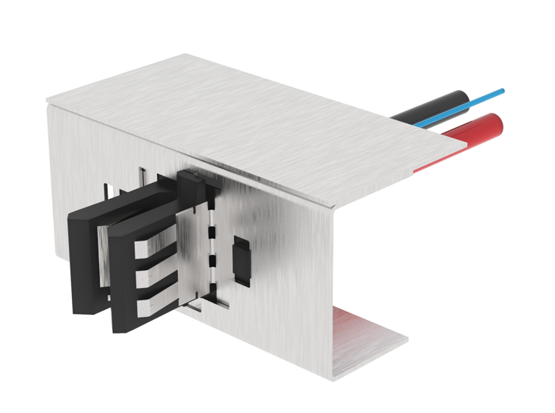
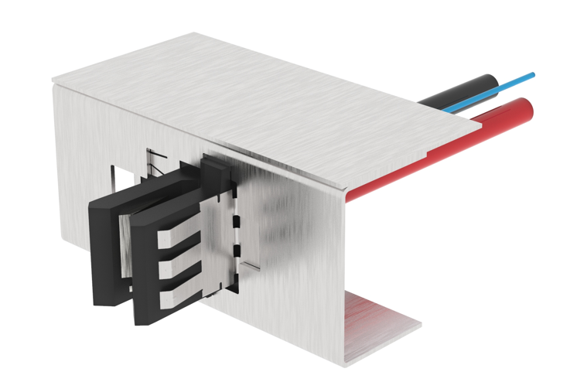
Tooless Design: Assembly
Slide connector toward the center of the opening
Insert connector into panel opening

Slide 12
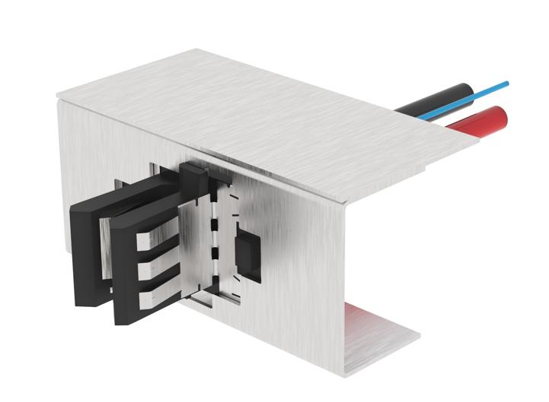
Tooless Design: Assembly
Push locking latch forward to lock connector inside the panel opening

Slide 13
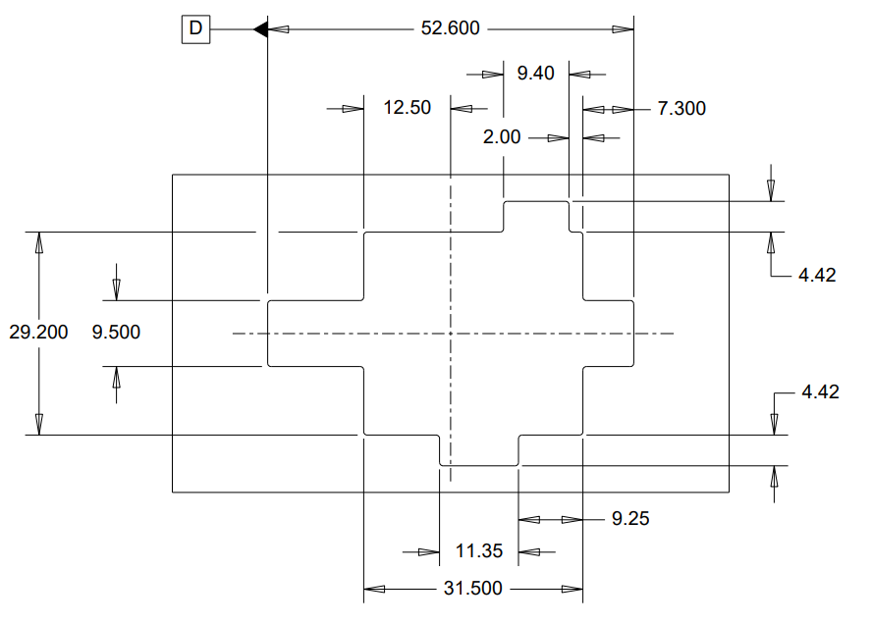
Tooless Design: Panel Cutout

