Slide 1
ACS Cold Plate Introduction
Jessica Gullbrand
Cold Plate Work Stream Lead
Advanced Cooling Solutions

Slide 2
ACS Cold Plate Purpose
Purpose: Generate an open requirement and supporting documents focusing on standardization and definitions of liquid cooled solutions without preventing innovation
Note: Cold plate work stream is focusing on liquid cooled solutions using cold plates

Slide 3
ACS Cold Plate Ongoing Efforts
Liquid Cooling Cold Plate Requirements
Harmonization
Rack Manifold Design - Rack & Power Project
Liquid Cooling Solution - Data Center Facility Project
OCP Member Contributions in the works
Universal Quick Disconnects
Wetted Materials & Cooling Liquids
Case Study

Slide 4
ACS Cold Plate Meetings
Cold Plate work stream meets Monthly
Every second Wednesday of the Month at 8 am PST
Reviews material generated by Focus Group
Reviews material brought in by OCP participants
Cold Plate Work Stream has 81 members
Monthly meeting has ~15 participants
Focus Group meets Weekly every Wednesday at 8 am PST

Slide 5
ACS Cold Plate Requirements
Focus group working on ACS Cold Plate Requirements
Technology Cooling System (TCS) fluid loop
Loop from CDU through rack manifold to IT equipment and back
Provide information/education, classification, and minimal requirement for OCP
Authors:
Jessica Gullbrand, Intel
Nigel Gore, Iceotope
Elizabeth Langer, CPC
https://docs.google.com/document/d/1f7supR2NAMiCMZVeT9mmS4-DogFta-cG_He8HRBWsM8/edit

Slide 6
ACS Cold Plate Requirements Inclusive
Hybrid Cooling: Liquid Cooling & Air Cooling
Full Liquid Cooling
Single- and Two-Phase Cooling

Slide 7
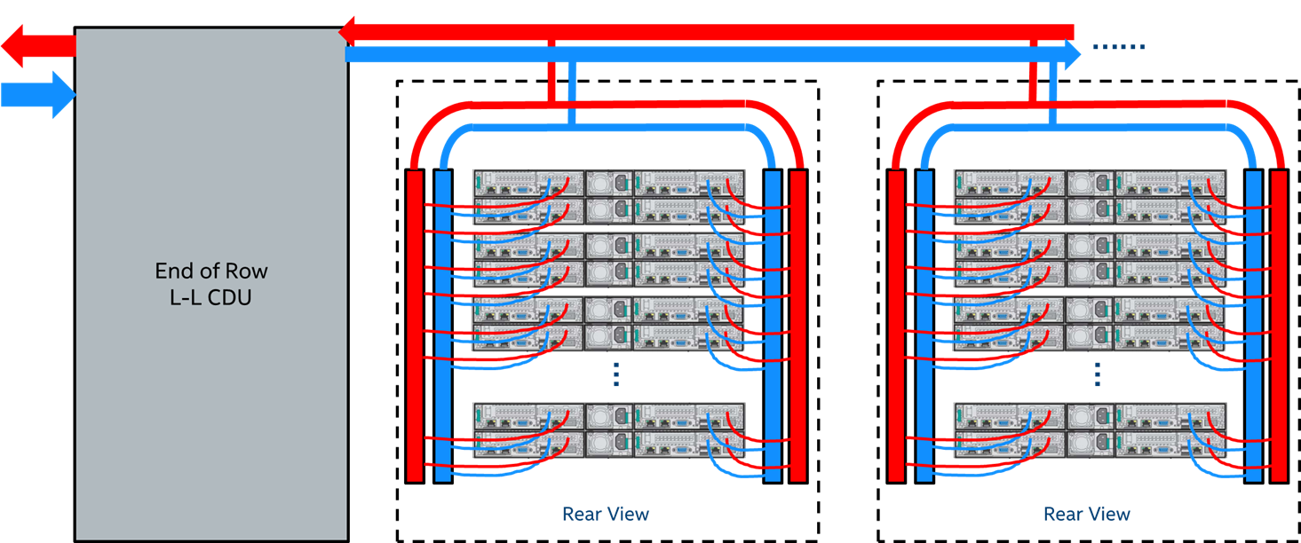
ACS Cold Plate Requirements Focus
Technology Cooling System (TCS) Example
© Figure by Intel, C. Winkel

Slide 8
ACS Cold Plate Requirements
TCS Components
Cooling Liquid
Coolant Distribution Unit
Rack Manifold
Fluid Connectors
Cold Plates

Slide 9
ACS Cold Plate Summary
Work streams goal is to generate an open requirement for liquid cooled solutions using cold plates
Currently working on
Liquid Cooling Cold Plate Requirements
Harmonization

