Slide 1
OCP Engineering Workshop Hosted by Flex
Rack and Power
Advanced Cooling Solutions
Data Center Facilities

Slide 2
ACS Door Heat Exchanger
Status
John Fernandes, Facebook

Slide 3
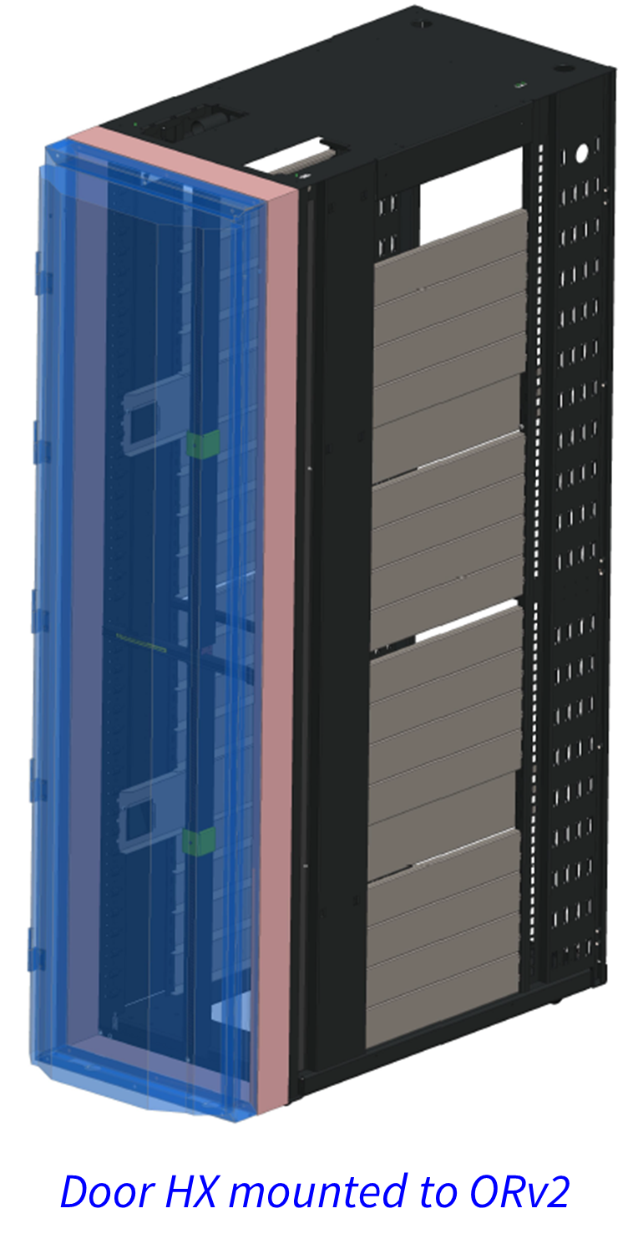
Door HX Work Stream
In-scope activities
Design specific to Open Rack only
Operating conditions and parameters
Metrology of heat extraction performance

Slide 4
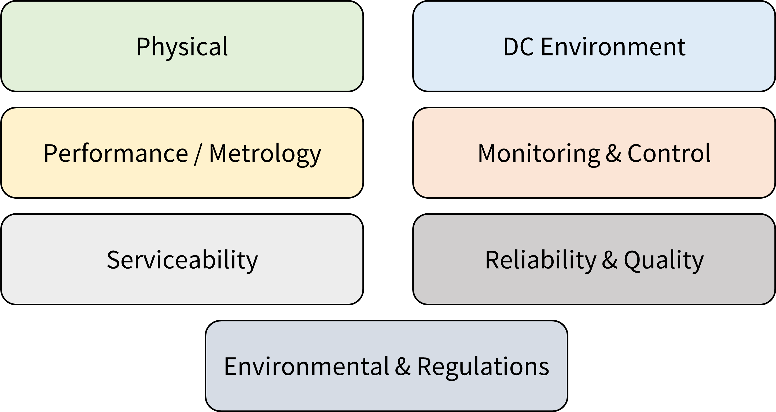
Specification

Slide 5
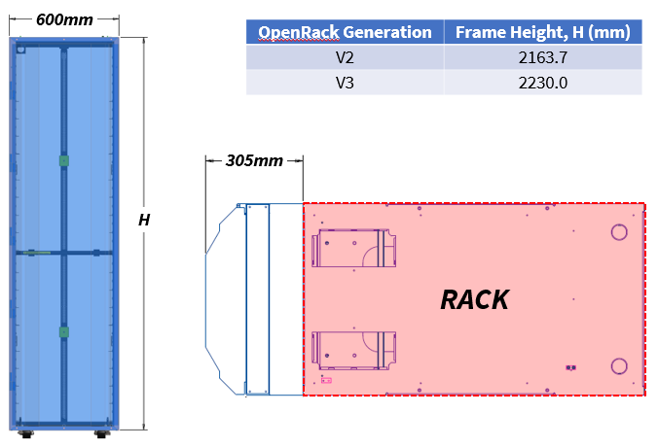
Specification
Physical

Slide 6
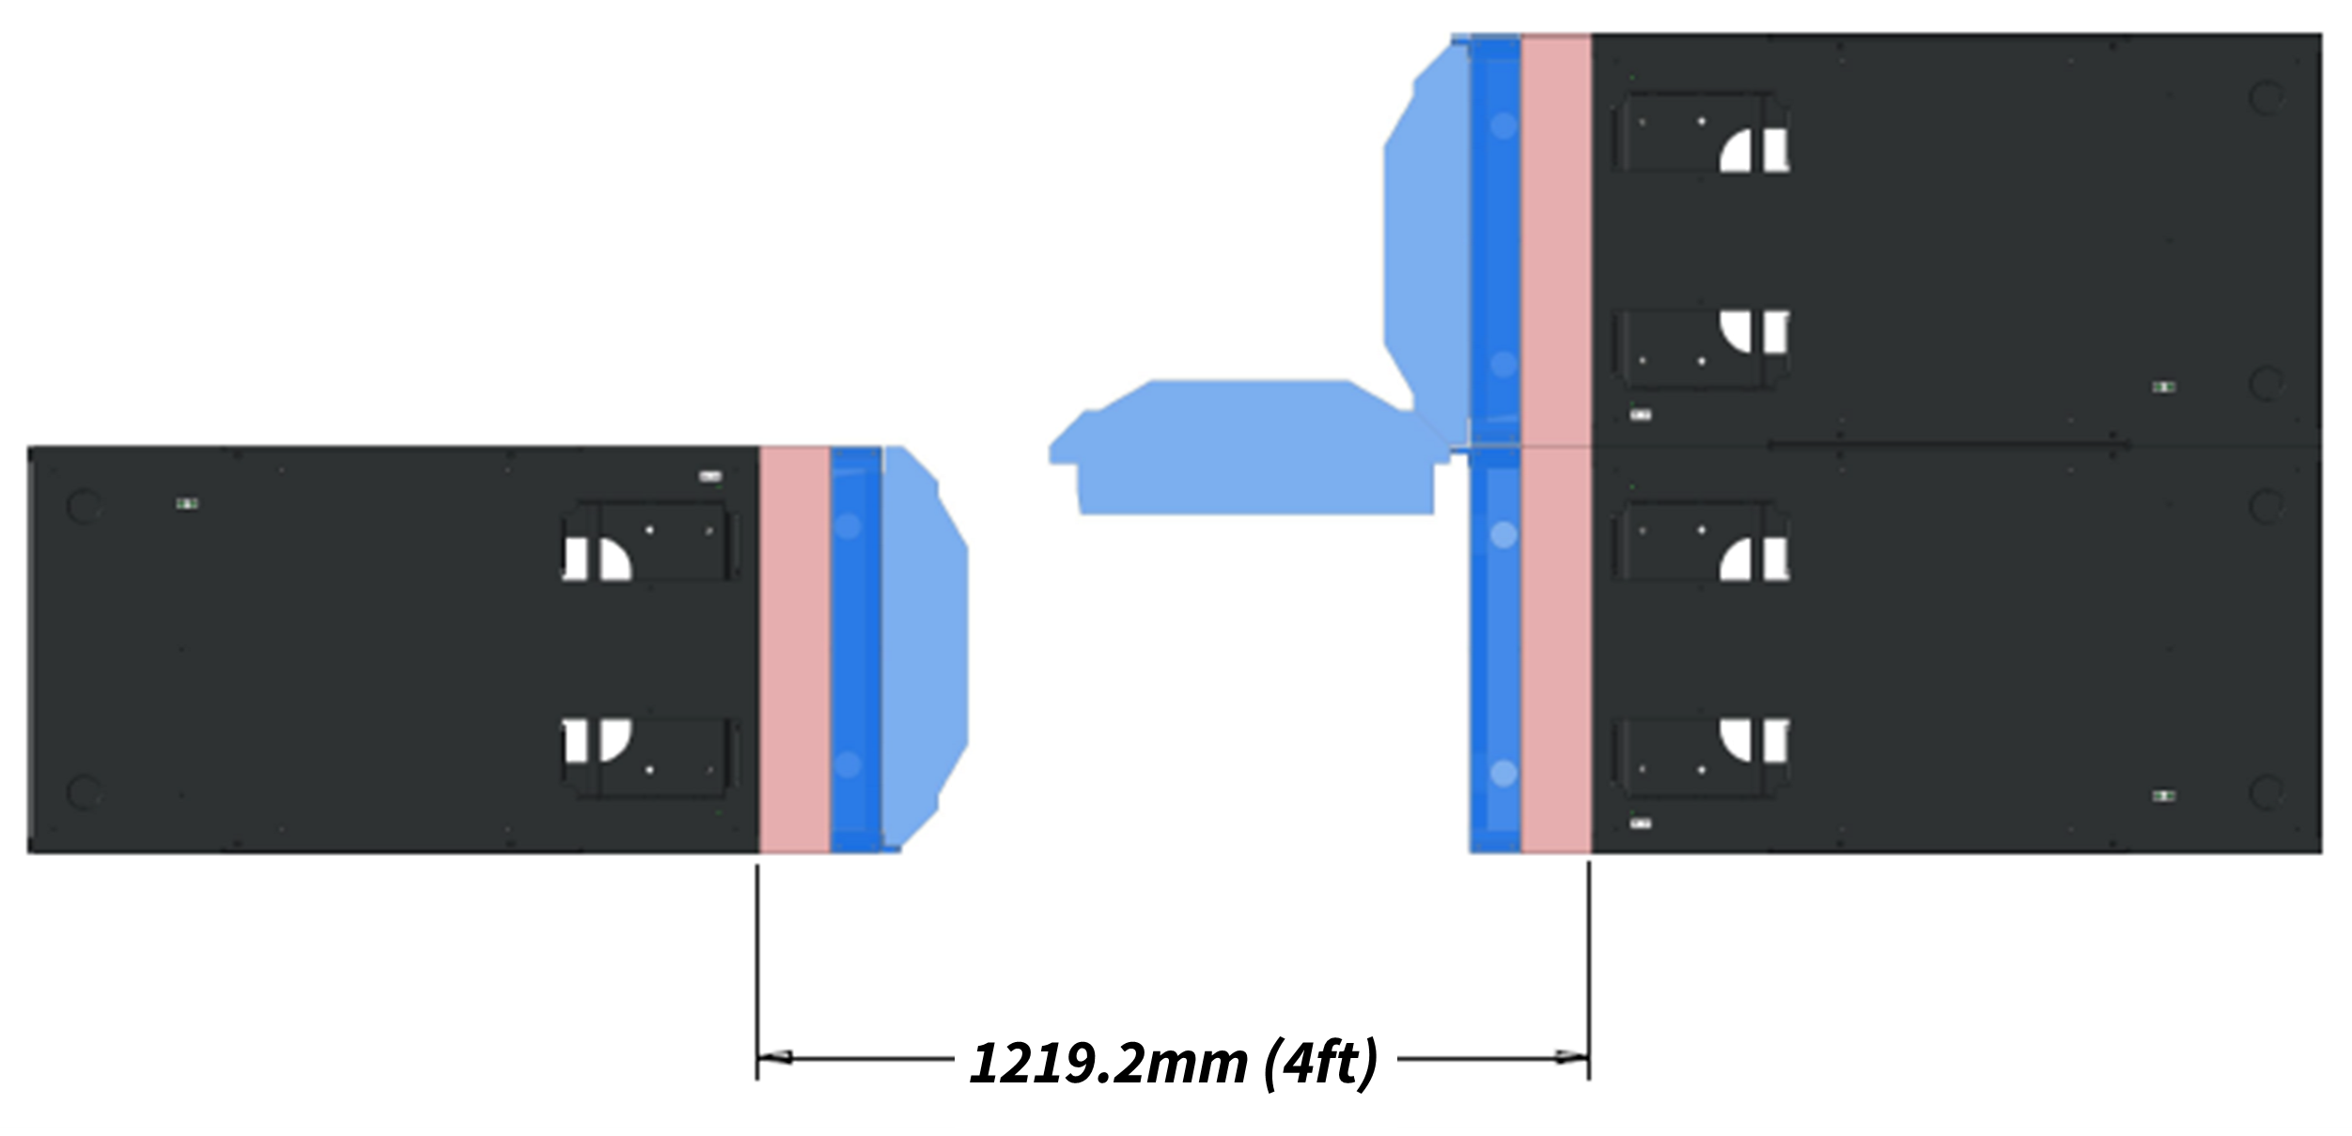
Specification
Hinged solution should permit opening of door by 90°
Physical

Slide 7
Specification
Air-side conditions
* or dependent on IT gear being supported; 12.2°C may serve as a reference value to define performance metrics under 100% neutralization of heat load
DC Environment
Cold-aisle Temperature | 18°C ~ 35°C (65°F ~ 85°F)
Temperature Ramp Rate | 5°C/15min
Cold-aisle Pressurization | 0.005” H₂O (1.24Pa)
Relative Humidity | 10% ~ 90%
Altitude | ≤ 2000m (6600ft)
Temperature Difference * | ≥ 12.2°C (22°F)

Slide 8
Specification
For active variant, N+1 rotor redundancy is a must
Face area of heat exchanger within supporting frame should be maximized for performance and minimal back-pressure
Performance curves for effective sizing of solution to IT gear and rack requirements
Low air-side pressure drop to minimize impact to server fans
For active variant, total power consumption should be ≤ 2% of rated heat rejection capacity
De-rating factor(s) for heat rejection capacity based on
Coolant selection (with respect to water)
Altitude (with respect to sea-level operation)
Performance / Metrology

Slide 9
Need for Harmonization
Align with or leverage in-scope activities
Interfaces to facilities
Fluid physical properties and types
Operating conditions and parameters
Maintenance and service of components within facility
Definitions for communication protocols

