Slide 2
What Defines a Modular Data Center?
Rob Coyle, Director, PCX Corporation
DCF/MDC

Slide 3
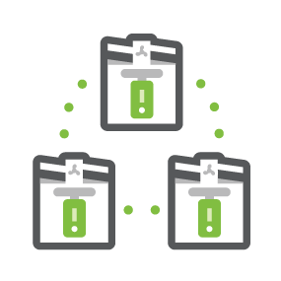
Outline
Discussion Mission
Goals of the Group (charter)
Current Status of MDC Group – Recent Submissions
Goals of this Discussion
Questions to prompt discussion
MODULAR DATA CENTER

Slide 4
Discussion Mission
Everyone to feel like they can share thoughts or ask questions.
Leverage the community.
Focus on the topic of MDCs.
Leave with a direction for the upcoming MDC GoToMeeting.
MODULAR DATA CENTER

Slide 5
Goals of the DCF/MDC Group
The OCP Data Center Facility Project will develop an open-source Modular Data Center Specification to support OCP Hardware and contribute it to the OCP Community. The collaborative Specification will include Design Files and Reference Architectures. Multiple Solution Providers can develop and offer an OCP Accepted product to the market from the Specification. The project will provide the capability for OCP Hardware users to leverage the inherent advantages of Modular Data Center advantages in efficiency and scalability.
MODULAR DATA CENTER

Slide 6
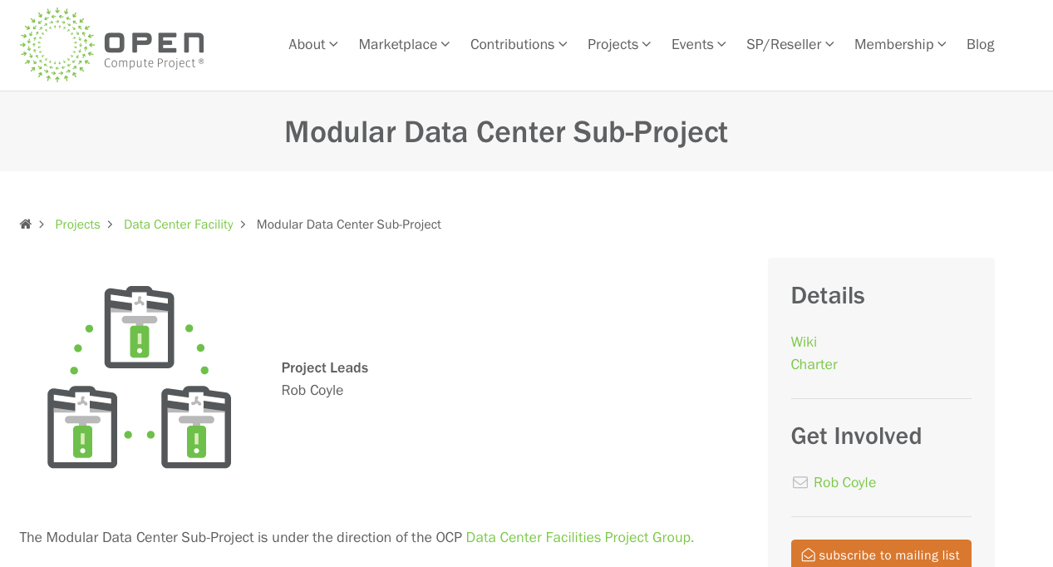
Goals of the DCF/MDC Group
MODULAR DATA CENTER

Slide 7
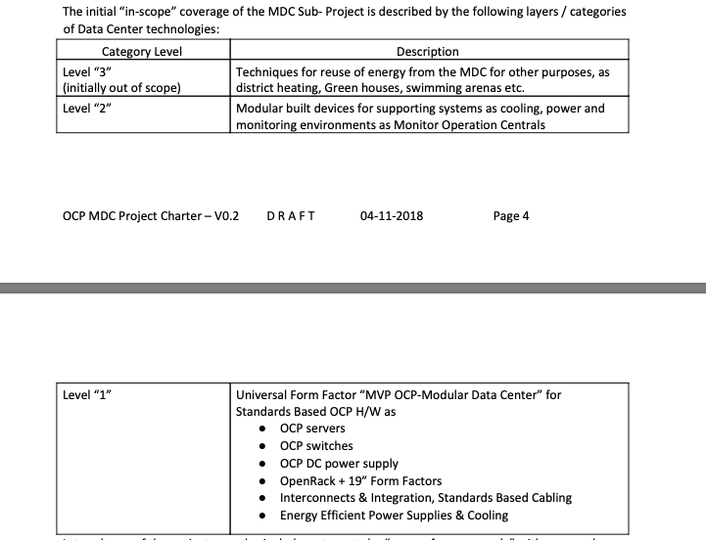
Goals of the DCF/MDC Group
MODULAR DATA CENTER

Slide 8
OCP Tenets = MDC
Efficiency
Prefabricated modules allow for manufacturing and deployment efficient, minimizing the amount of work and waste onsite. The base design of this module is in row to reduce stranded capacity with hot aisle containment.
Scalability
This modular design for Data Centers scale well for any requirement, for customers who look for “pay as you grow” solutions additional modules are easily added.
Openness
Specifications allow multiple vendors to bid on the same concept, giving users greater choice and supply chain redundancy.
Impact
This effort is the industry’s first attempt to standardize how prefabricated MDCs are described. If adopted and further developed, it will vastly improve the efficiency in which customers and vendors specify MDCs.
MODULAR DATA CENTER

Slide 9
Goals of our Discussion
Explore current market needs
Lessons learned when using Modular Data Centers
Define next focus of the group. (ie. evolve current design/spec, create new spec, subgroup partnerships, etc.)
MODULAR DATA CENTER

Slide 10
Questions
Who has installed, operated, used an MDC?
What’s the expectations that an MDC can provide?
What’s the biggest challenge facing the DC market right now that MDC could solve?
What is the biggest challenge limiting the use of an MDC?
Regulatory? Operating? Right sizing?
MODULAR DATA CENTER

Slide 11
Advance MDC with us!

Slide 12
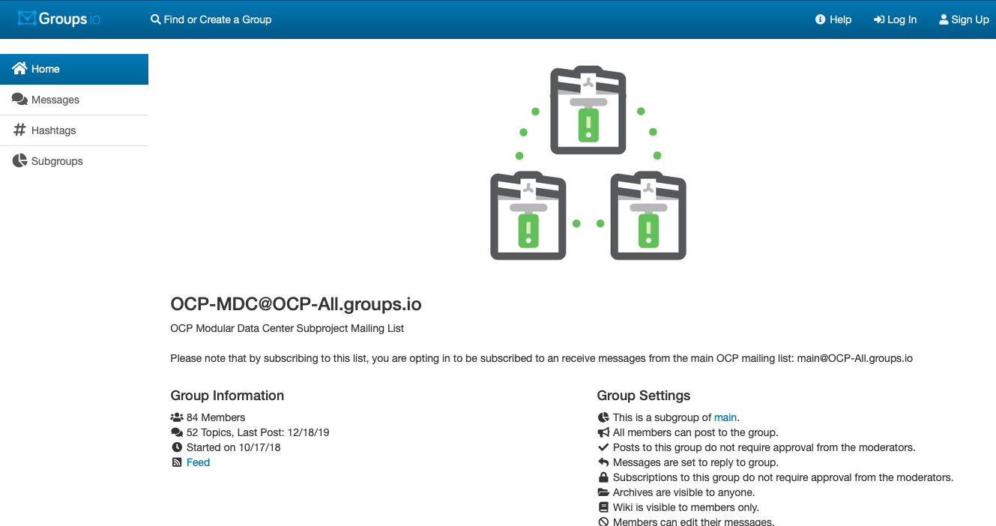
Advance MDC with us!

Slide 13
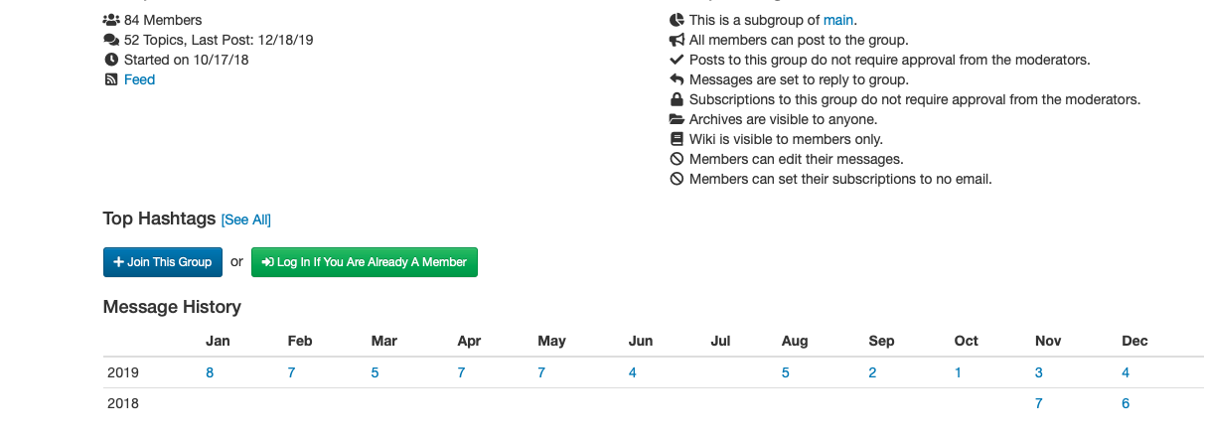
Advance MDC with us!

Slide 14
Advance MDC with us!
https://ocp-all.groups.io/g/OCP-MDC
Cooling solutions, Rack Layout, UPS solutions, etc.
Next meeting date April 1st (no joke!)

