Slide 2
Colo Facility Guidelines and OCP Ready TM Assessment Revision
Mark Dansie, OCP Ready TM Lead, OCP Foundation
DCF/MDC
DATA CENTER FACILITIES

Slide 3
Introduction
Why were the guidelines created?
What is the purpose of the OCP Ready TM program?
Why are we revising these documents?
DATA CENTER FACILITIES

Slide 4
Guidelines Revision Update
Chapters
Reference designs
Appendices
DATA CENTER FACILITIES

Slide 5
Existing Chapters
Architectural
Cooling
Electrical Systems
DATA CENTER FACILITIES

Slide 6
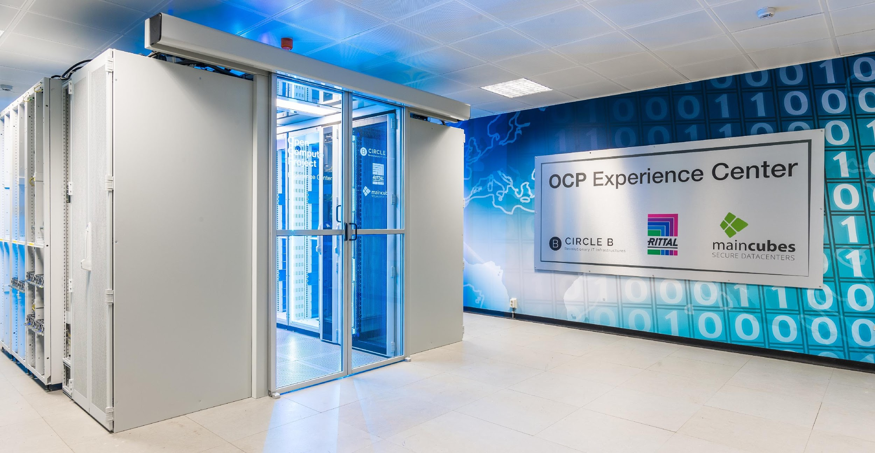
Architectural
DATA CENTER FACILITIES
Photo courtesy of Maincubes
Reference design for OCP Pods

Slide 7
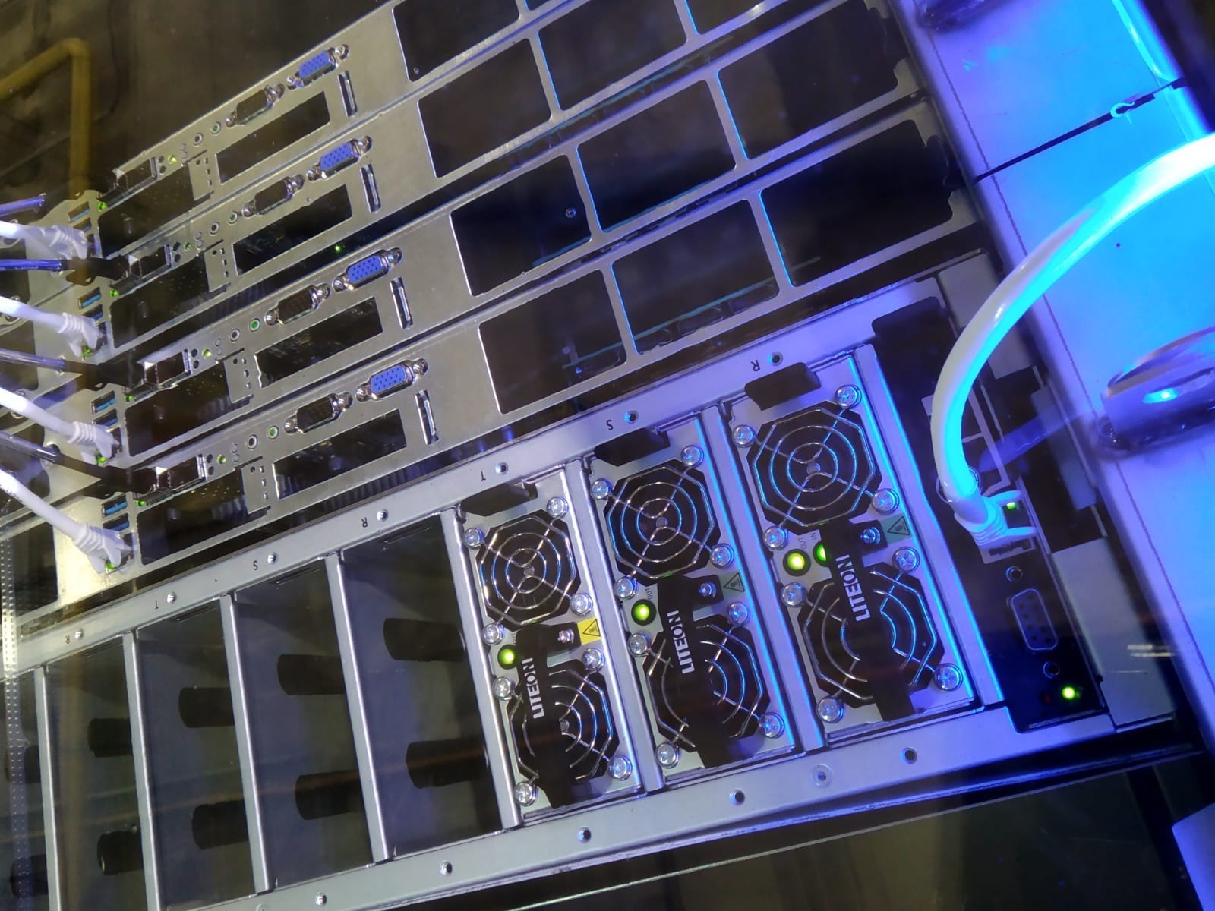
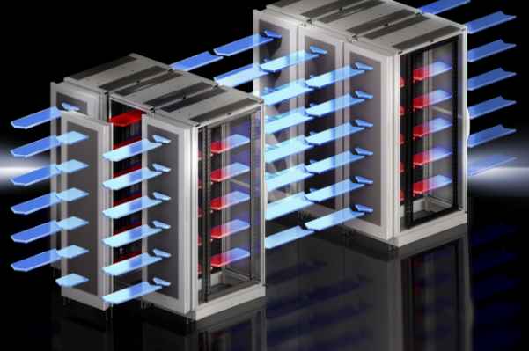
Cooling
DATA CENTER FACILITIES
Photo courtesy of Rittal
Photo courtesy of Submer
Door HEX
Immersion
Reference design for ACS

Slide 8
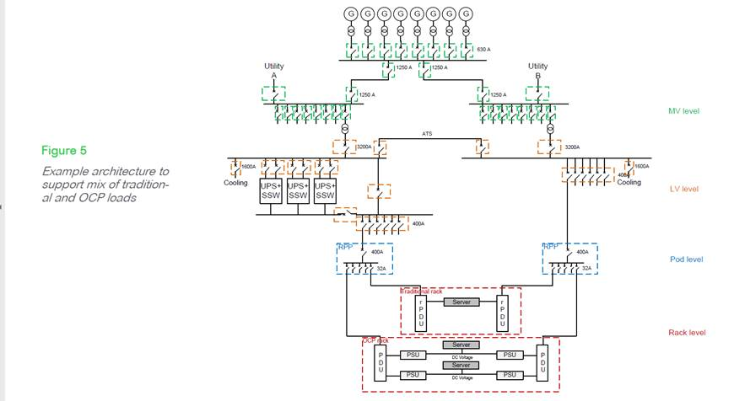
Electrical Systems
DATA CENTER FACILITIES
SLD courtesy of Schneider Electric
Reference design for electrical architecture

Slide 9
New Chapters
Sustainability
Safety and Compliance
SLAs
DATA CENTER FACILITIES

Slide 10
Appendices
Highlight ‘Requirements’ matrix
Add and retire rack types
Add references to related sub-projects
Add references to other OCP projects
DATA CENTER FACILITIES

Slide 11
OCP Ready TM Site Assessment Revision Update
Add Site Operations Standards to ‘Considerations’
OCP CFOPS Framework
BICSI 009-2019
Other framework or standard
Proprietary or in-house processes

Slide 12
Questions?

Slide 13
Call to Action
Links
DCF Project
DCF Mailing List
Membership - How to Join
Facility Recognition Program
Marketplace
OCP Foundation Contacts OCP Ready TM Lead: mark.dansie@opencompute.org VP of Channel: steve.helvie@opencompute.org
Data Center Facility Project - Volunteer Leader Contacts​
Project Lead: Jim.Gordon@ocproject.net​
Incubation Committee Representative: Brevan.Reyher@ocproject.net​

