Slide 2

Data Center Electrical Spec for System Stability
Melaku Mihret, Electrical Engineer, Facebook
DATA CENTER FACILITIES

Slide 3

Why the Spec for System Stability?
Ensure electrical system stability by design
Address end-to-end system requirement
Minimize voltage unbalance
Notes:
Defines limits for all passive electrical components
Provide impedance measurement guideline

Slide 4
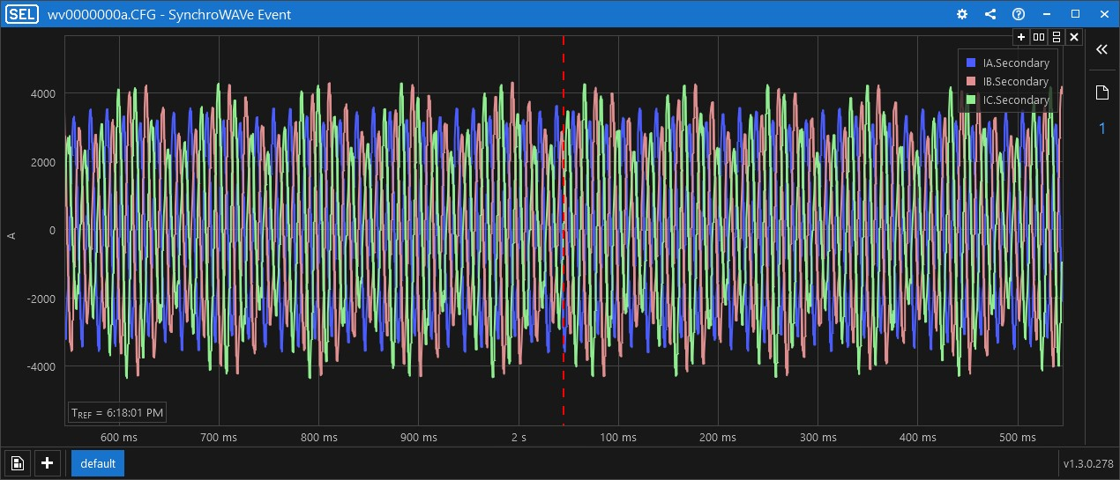
Main Switchboard (MSB) Currents
Phase A
4000
Phase B
Phase C
-2000
Current (A)
0
000
-4000
0 ms
200 ms
100 ms
100 ms
600 ms
800 ms
100 ms
400 ms
2s
100 ms
100 ms
100 ms
1 s
Notes:
Instability and resonance at multiple sites
System resonance at 71 Hz leads to high harmonics in current

Slide 5
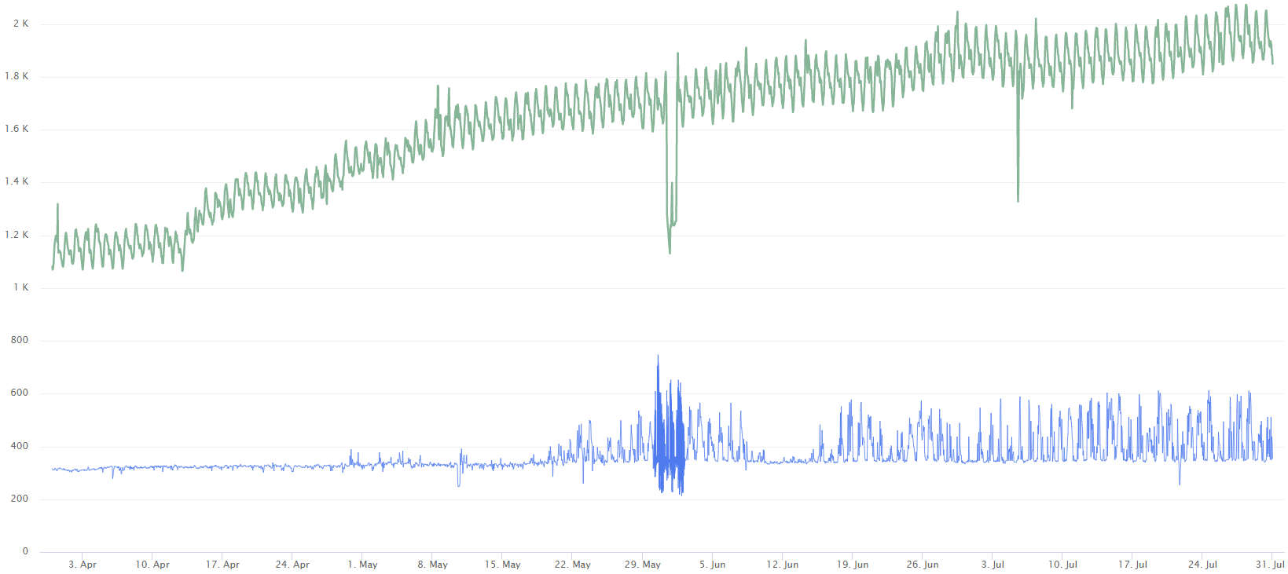
Origin of the Resonance
2000
Total MSB Load (kW)
1600
The impedance interaction between the building electrical system and the power supplies are the root cause.
1000
MSB Neutral Current (A)
MSB Neutral Current Spikes
0
April 2017
May 2017
June 2017
July 2017
August 2017
Notes:
Root cause - impedance interaction between the building electrical system and the power supplies
Also observed huge spike on the power and the neutral current at higher power.
Nonlinear coupling through converter generates additional harmonic at 49 Hz ($71+49=2×60$)

Slide 6
Simplified Electrical System
Normal Path
G
MSB Bypass
Reactor
SB-RPP Bypass
PSU
Substation
G
RPP
Utility
SB
Busway
PTX
MSB
MVS
Notes:
Multiple redundancy paths

Slide 7
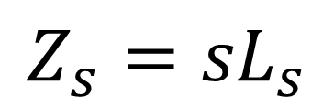
Impedance Analysis
Z_{s}(s)
Single-phase equivalent circuits,
one in each sequence
G
Reactor
$${Z_{s}=sL}_{s}$$
Z_{s}(s)
Z_{l}(s)
PSU
Substation
G
RPP
Z_{l}(s)
Utility
Three-phase power distribution system
Notes:
Three-phase power distribution system
Reduction to three single-phase equivalences based on symmetrical component theory
We need to find a we to determine the equivalent impedance of the complex system

Slide 8
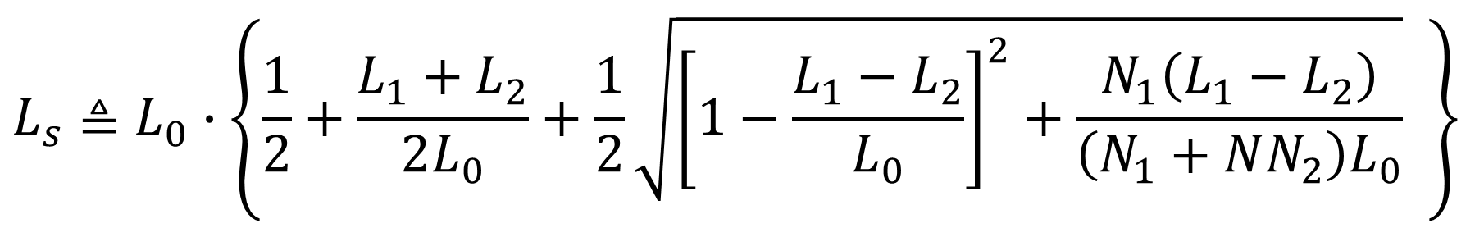
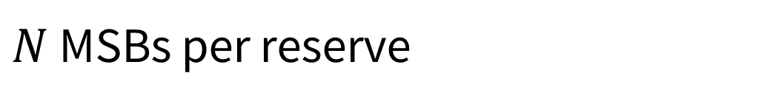
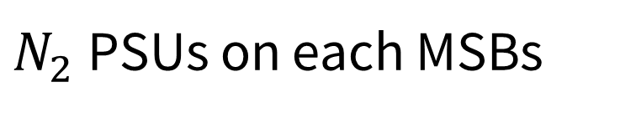

Equivalent Building Impedance
Nonhomogeneous Loading
L₁
$N_{1}$PSUs on reserve MSB
PSU
L₂
L₀
L_{s}
PSU
PSU
$N_{2}$PSUs on each MSBs
Utility
L₂
PSU
$$L_{s}≜L_{0}∙\left\{\frac{1}{2}+\frac{L_{1}+L_{2}}{2L_{0}}+\frac{1}{2}\sqrt{{\left[1−\frac{L_{1}−L_{2}}{L_{0}}\right]}^{2}+\frac{N_{1}\left(L_{1}−L_{2}\right)}{\left(N_{1}+NN_{2}\right)L_{0}}} \right\}$$
$N$ MSBs per reserve
Notes:
System Stability can be Determined by Testing one PSU Against a Source with Output Impedance Defined by $L_{s}$
Applied scaling on the impedances
The equivalent source inductance are computed based on the maximum eigenvalues of the loop gain

Slide 9

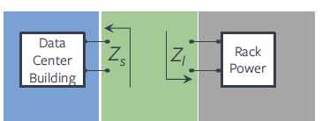
Base Impedance Ratio (BIR)
BIR is the ratio of PSU to building impedance
The system is more stable if:
Building inductance is small
Power supply input impedance is large
Data Center Building
Power Supply
Z_{s}
Z_{l}
Notes:
BIR is the ratio of PSU to building impedance.
Lower building impedance is better for stability.
The higher the operating voltage, the better.

Slide 10
Building Requirement
Base Impedance Ratio | Conclusion
> 2.5 | Pass
2.0 – 2.5 | Marginal Pass
1.5 – 2.0 | Marginal Fail
< 1.5 | Fail
Notes:
Field impedance measurement from multiple sites
Testing the PSUs with equivalent inductors

Slide 11
Power Supply Requirement
Base Impedance Ratio | Conclusion
> 2.0 | Fail
1.5 – 2.0 | Marginal Fail
1.0 – 1.5 | Marginal pass
< 1.0 | Pass
Notes:
Field impedance measurement from multiple sites
Testing the PSUs with equivalent inductors

Slide 12
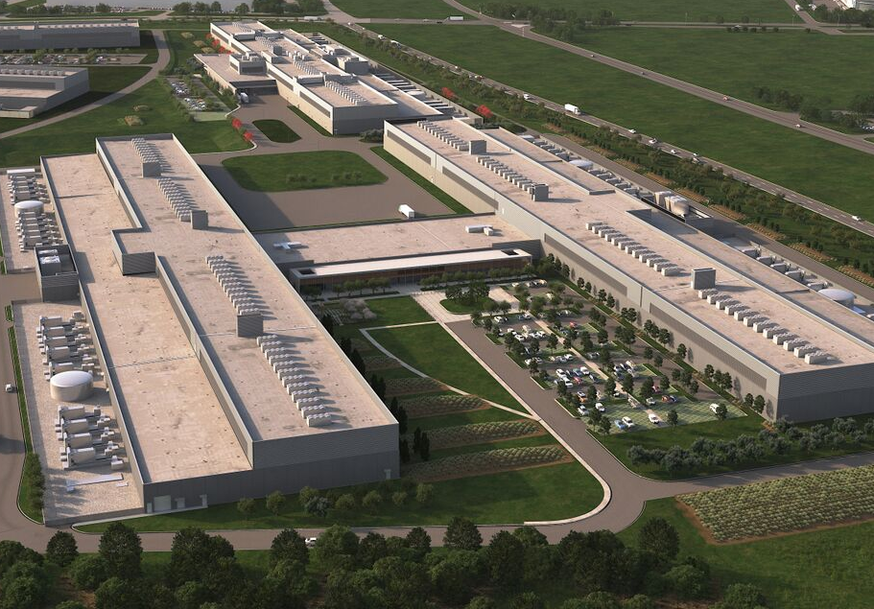
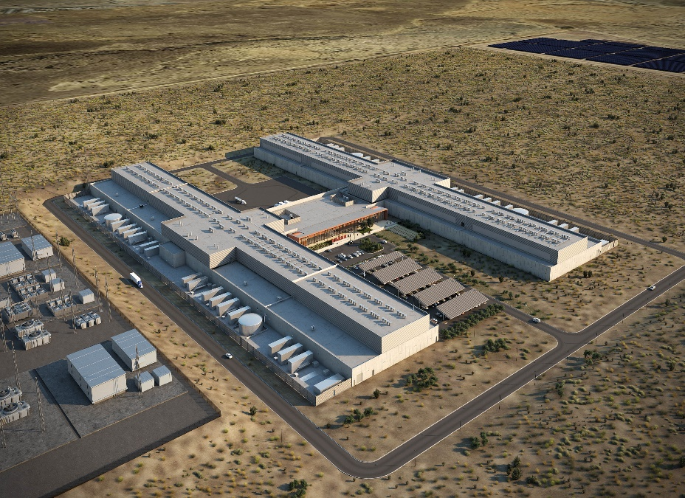
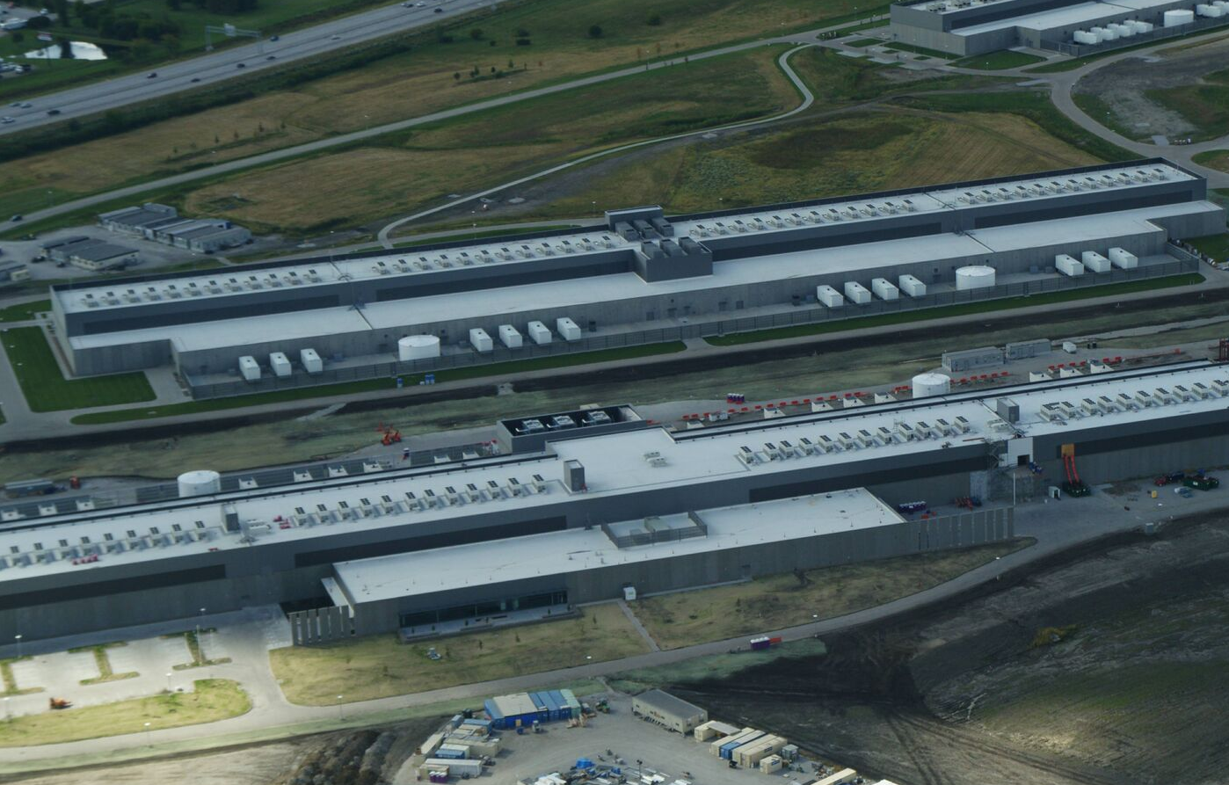
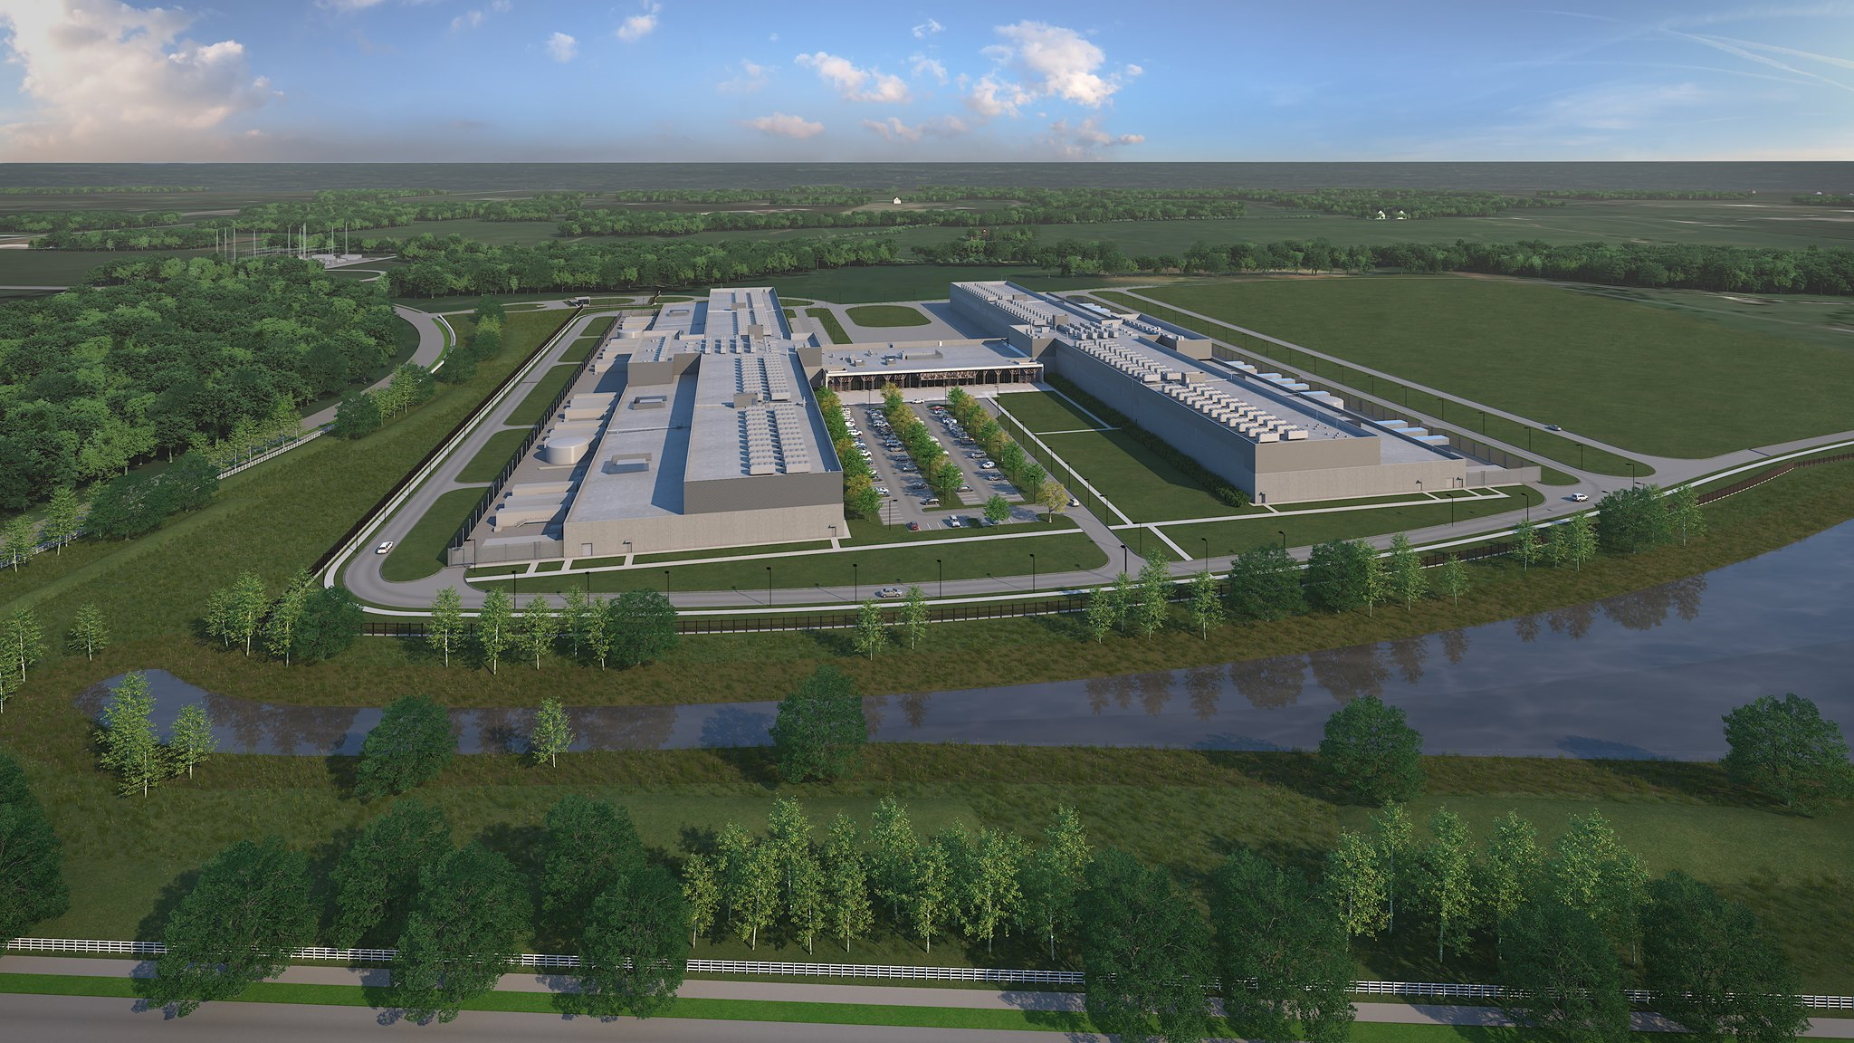
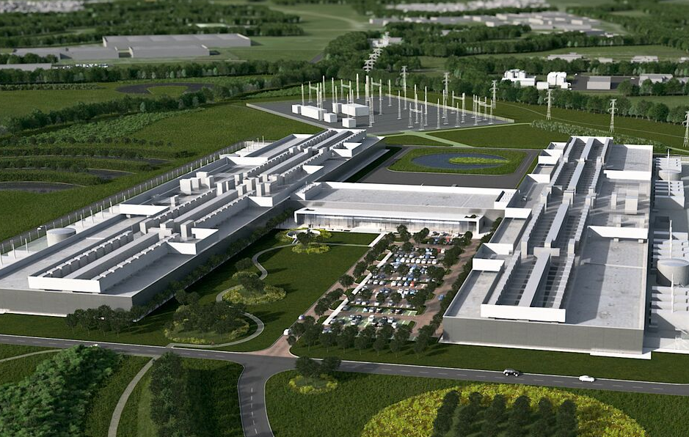
Site Impedance Measurement
Fort Worth, TX
Los Lunas, NM
Altoona, IA
Ashburn, VA
New Albany, OH
Clonee, Ireland

Slide 13
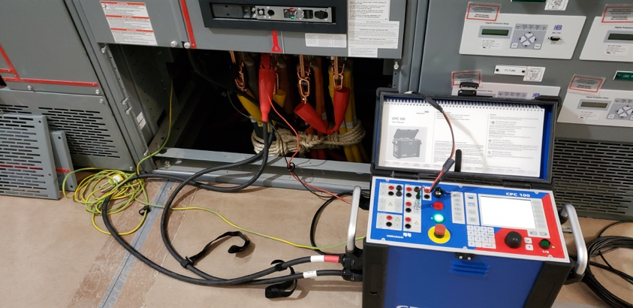
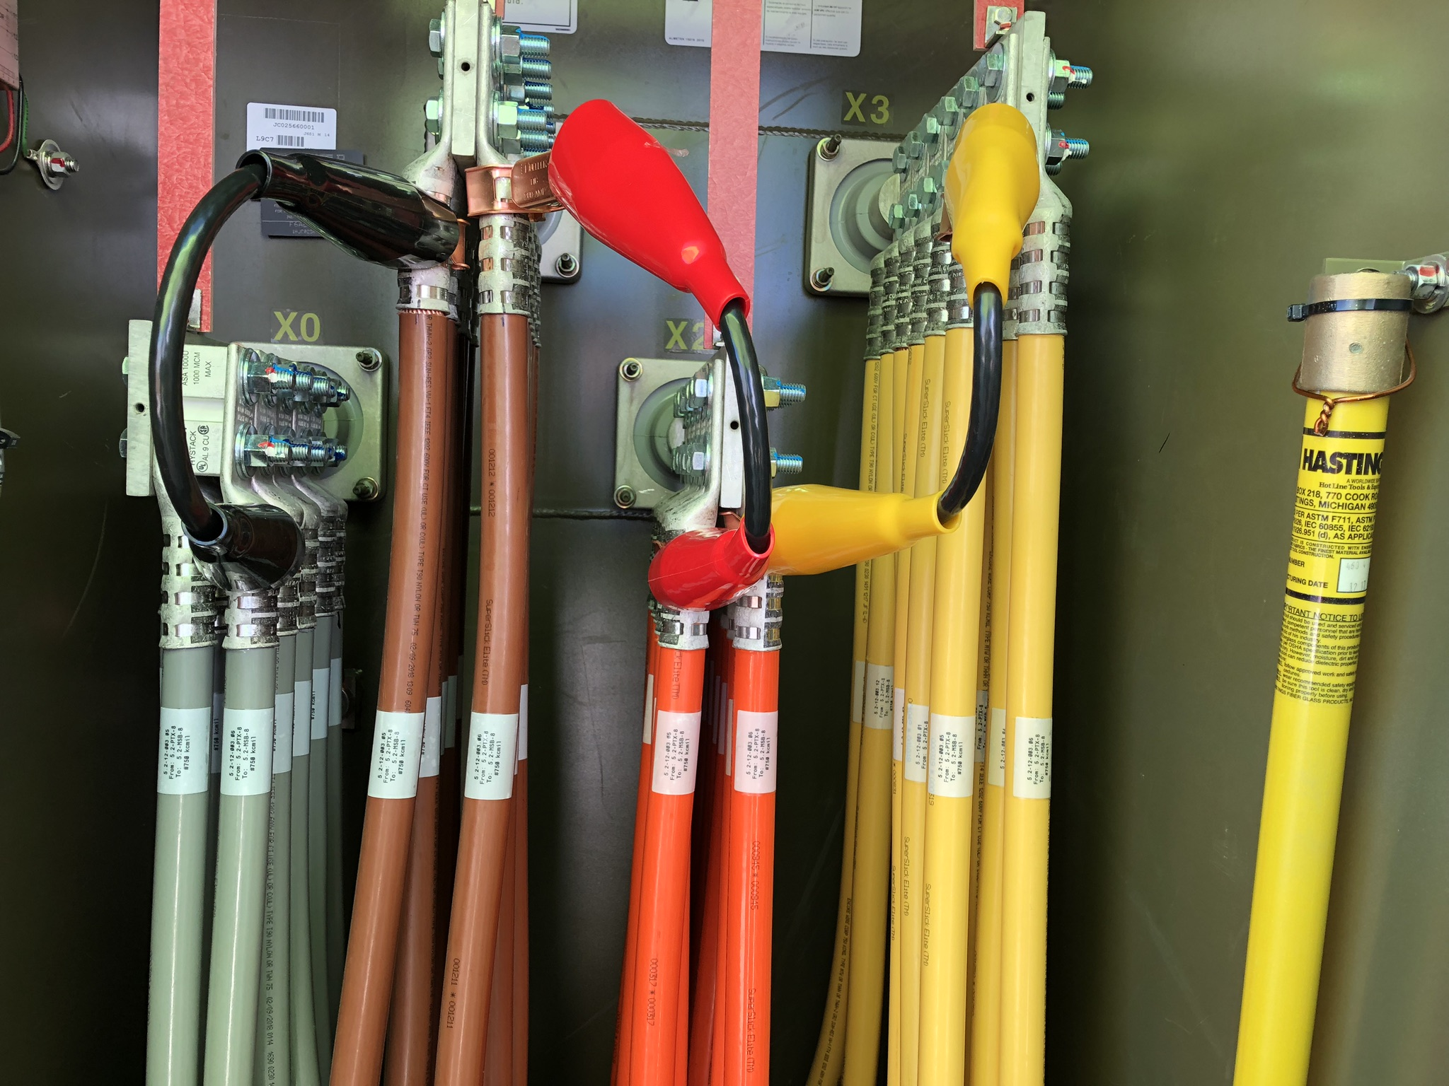
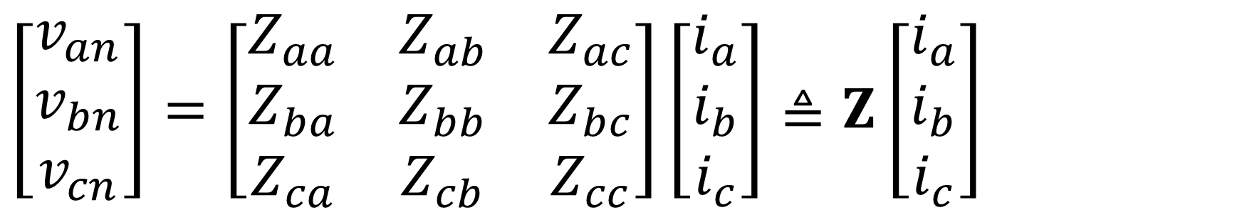
Data Center Impedance Measurement
High Current Injection Wire
Shorting Wire
a
Device
Under
Test
+
b
Isource
Vmeas
c
-
n
$\left[\begin{matrix}v_{an} \\ v_{bn} \\ v_{cn}\end{matrix}\right]=\left[\begin{matrix}Z_{aa} & Z_{ab} & Z_{ac} \\ Z_{ba} & Z_{bb} & Z_{bc} \\ Z_{ca} & Z_{cb} & Z_{cc}\end{matrix}\right]\left[\begin{matrix}i_{a} \\ i_{b} \\ i_{c}\end{matrix}\right]≜Z\left[\begin{matrix}i_{a} \\ i_{b} \\ i_{c}\end{matrix}\right]$
Notes:
We measure the impedance of every segment in the low voltage distribution system.
We test at various frequencies
We compute the utility and substation transformer impedances.

Slide 14
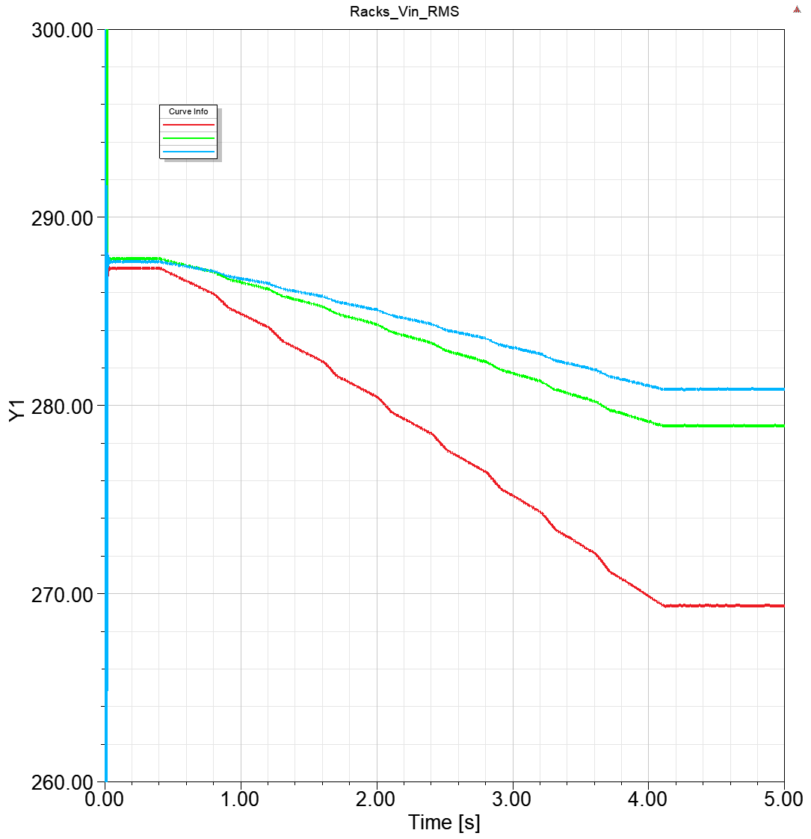
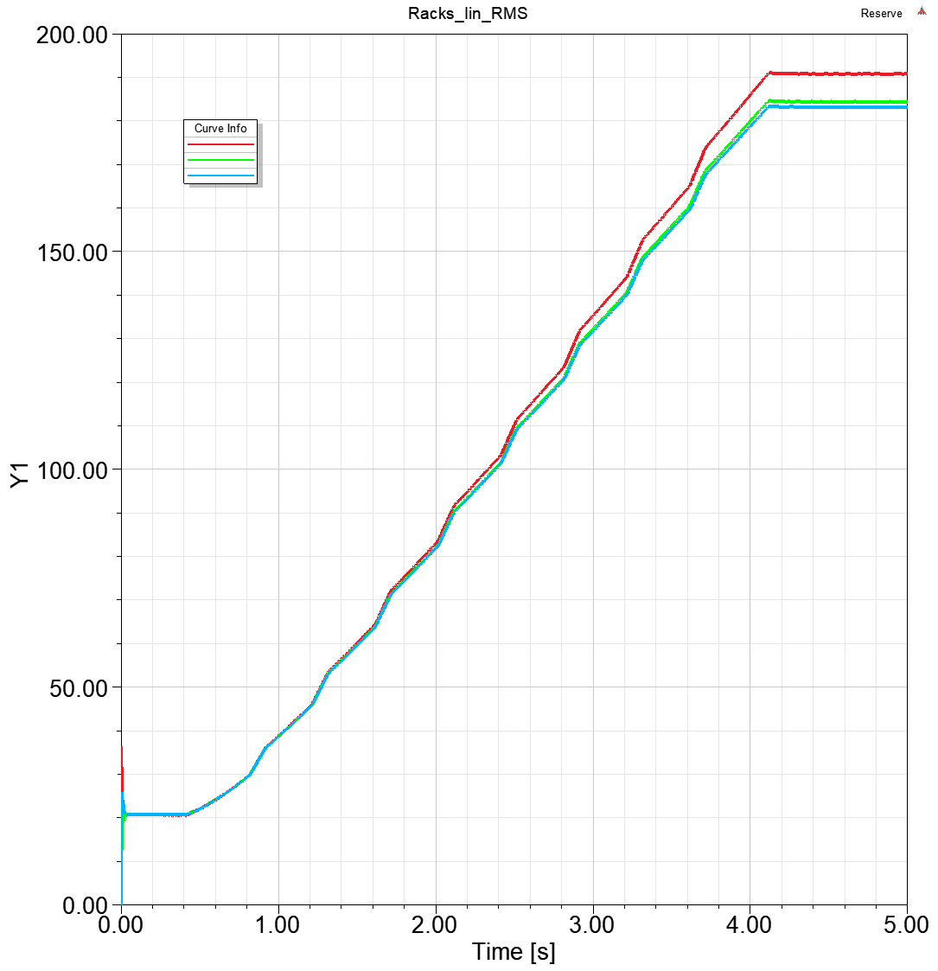
Software Modeling
Racks Input Voltage
Racks Input Current
Phase A
Phase A
Phase B
Phase B
Phase C
Phase C
Vrms (V)
Irms (A)
Stable rack voltages
Stable rack currents
Time (s)
Time (s)
Notes:
Models built in and simulations performed with ANSYS Simplorer

Slide 15
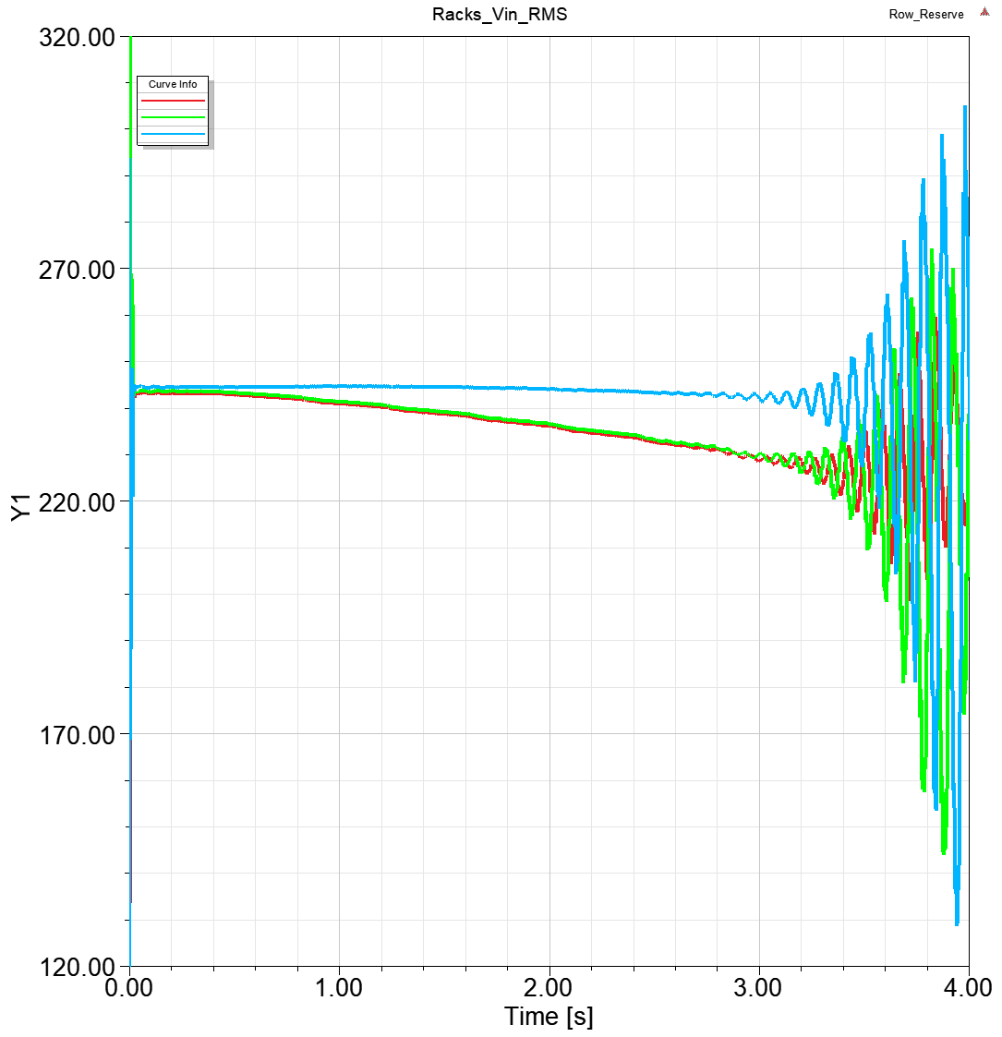
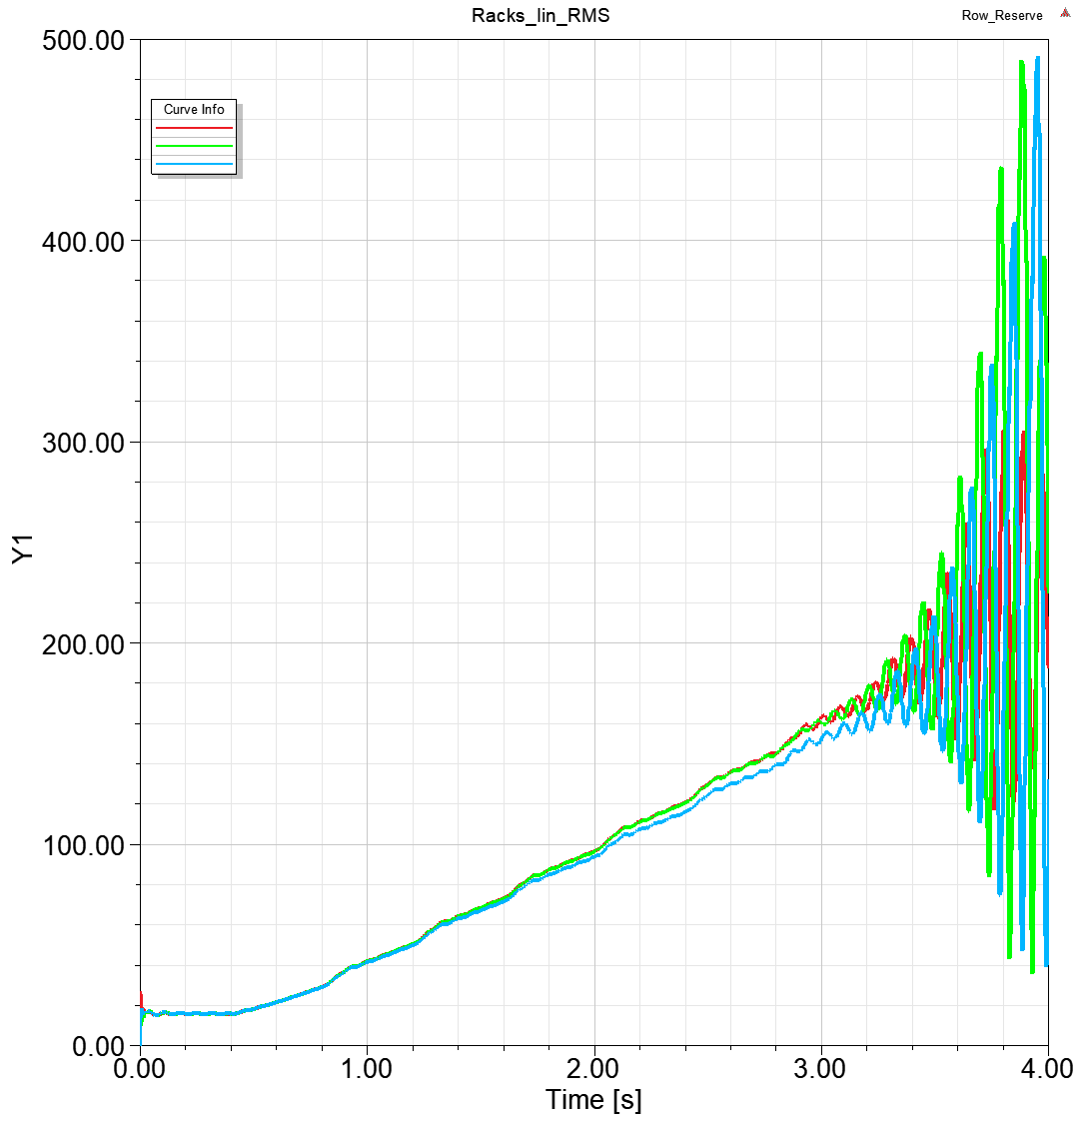
Model with Failed PSU
Racks Input Voltages
Racks Input Currents
Phase A
Phase A
Phase B
Phase B
Phase C
Phase C
Vrms (V)
Irms (A)
Unstable rack currents
Unstable rack currents
Unstable rack voltages
Unstable rack voltages
Time (s)
Time (s)

Slide 16
Impedance Spec
The spec ensures system stability by design
Specify the maximum inductance limit
Applies to all passive electrical components - Switchboards, Reactors, Busways and Cables
Examples of the Spec
 | Main Switchboard | Reactor | Busway
Average self-inductance | 12.0 µH | 65.0 µH | 13.0 µH
Self-inductance deviation | 3.0 µH | 1.0 µH | 1.5 µH
Average mutual inductance | 6.5 µH | 1.0 µH | 7.5 µH
We are engaging vendors to meet this spec and to develop a process of impedance testing
Notes:
The spec is defined based on three key parameters, average self and mutual inductance determines the stability; inductance deviation defines the voltage unbalance.
Specify the maximum inductance limit for each passive electrical component
These components include: MSBs, SBs, RPPs, Agg Reactors, PDUs, STCs and Cables
Started vendor engagement

Slide 17
Impedance Composition
Notes:
MSB and PTX contribute the most inductance in the normal path
Agg Reactor and MSB the dominance impedance contributors in row reserve loop

Slide 18
Main Switchboard Comparison
Fail
Inductance (µH)
Spec
Pass
Notes:
We analyzed and compared 5 switchboard vendors and integrators, compared with the spec limit
1 Vendor failed the inductance limit

Slide 19
Main Switchboard Comparison
Inductance (µH)
Spec
Notes:
3 vendors passed the mutual inductance limit

Slide 20
Main Switchboard Comparison
Inductance (µH)
Spec
Notes:
Inductance deviation derives the voltage unbalance
All vendors pass this spec

Slide 21
How to Improve System Stability?
Notes:
Reduce the building impedance
Increase PSU input impedance – a lot of work with PSU vendors. Also there is an OCP presentation

Slide 22
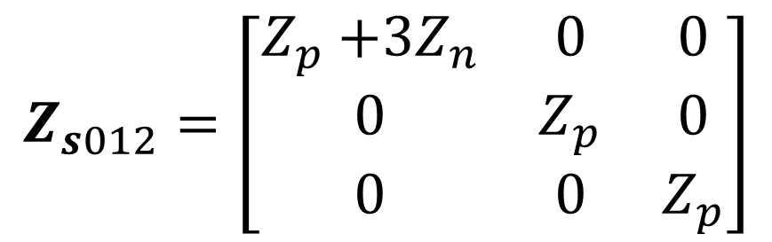
Zero Sequence is the Weakest Link
$$Z_{s012}=\left[\begin{matrix}Z_{p}{+3Z}_{n} & 0 & 0 \\ 0 & Z_{p} & 0 \\ 0 & 0 & Z_{p}\end{matrix}\right]$$
G
Reactor
Delta Configuration
PSU
Substation
G
RPP
Utility
SB
Busway
PTX
MSB
MVS
Delta Configuration is better for zero-sequence stability
Notes:
Zero-sequence impedance is the weakest link

Slide 23
Increase Phase-Neutral Coupling
Existing cable bus
Proposed cable bus
A
C
A
C
A
C
N
N
A
C
N
B
A
N
C
B
B
B
B
B
B
B
N
N
B
A
N
C
B
N
A
C
C
A
C
A
C
A
N
N
C
B
N
A
C
N
B
A
Inductance in nH/m
Inductance in nH/m
203
 | 242
 |  | 199
130
 | 131
 |  | 131
Zero-Sequence Inductance = 533 nH/m
Zero-Sequence Inductance = 286 nH/m
Phase arrangement is key to reduce cable impedance
Notes:
Improve system stability by reducing the impedance
Reduce zero-sequence inductance by half

Slide 24
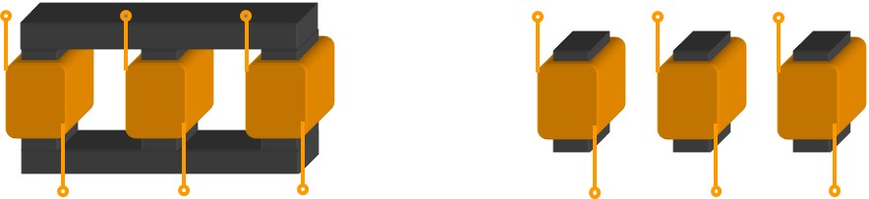
Utilize Phase Coupling
Single-Phase core reactor
Three-Phase core reactor
Inductance (µH)
60.9 | 0.5 | 0.6
0.6 | 60.2 | 0.6
0.5 | 0.5 | 61.5
Inductance (µH)
60.9 | -11.9 | -11.9
-11.9 | 60.2 | -11.9
-11.9 | -11.9 | 61.5
Zero-Sequence BIR
2.28
Zero-Sequence BIR
2.57
3-phase core reactors are better for system stability than reactors with 3 single-phase cores
Notes:
Negative mutual inductance reduces the zero-sequence
Zero-sequence impedance is the weakest link

Slide 25
Contributors
Dr. Jian Sun, Professor, Rensselaer Polytechnic Institute
Morris Toporek, DCD, Facebook
Greg Epstein, SE&D, Facebook
Debra Vieira and Mike Tu, FacEng, Facebook
Hamid Keyhani, Ted Tang and David Sun, Hardware Eng, Facebook

Slide 26
Call to Action
https://www.opencompute.org/projects/data-center-facility

