Slide 2
An Introduction to ACS Cold Plate Focus Areas
Jessica Gullbrand, Cold Plate Work Stream Lead, Intel
Advanced Cooling Solutions

Slide 3
Outline
Objective
Status
ACS Cold Plate Requirements
Process
Document
Requirements Checklist
ACS ORV3 Blind Mate Liquid Cooling
Objective
Status
Summary
ADVANCED COOLING SOLUTIONS

Slide 4
Objective
Cold Plate Work Stream Objective
Generate an open specification and supporting documents focusing on standardization and definitions of liquid cooled solutions and interfaces without preventing innovation

Slide 5
Status
ACS Cold Plate Ongoing Focus Areas
Liquid Cooling Cold Plate Requirements – approved
Open Rack V3 Blind Mate Liquid Cooling – initiated
Harmonization
ACS work streams – Cold Plate, Door Heat Exchanger, Immersion
Rack Manifold Design - Rack & Power Project
Liquid Cooling Solution - Data Center Facility Project
OCP Member Contributions in the works
Universal Quick Disconnects
Wetted Materials & Cooling PG Liquids
Liquid Cooling Installation Learnings

Slide 6
ACS Cold Plate Requirements
Technology Cooling System (TCS) fluid loop
Loop from CDU through rack manifold to IT equipment and back
Provide information, classification, and minimal requirement for OCP liquid cooled solutions
Authors:
Jessica Gullbrand, Intel
Nigel Gore & Jason Matteson, Iceotope
Elizabeth Langer, CPC – Colder Products Company
+ incorporated feedback from cold plate work stream community
https://www.opencompute.org/documents/ocp-acs-liquid-cooling-cold-plate-requirements-pdf

Slide 7
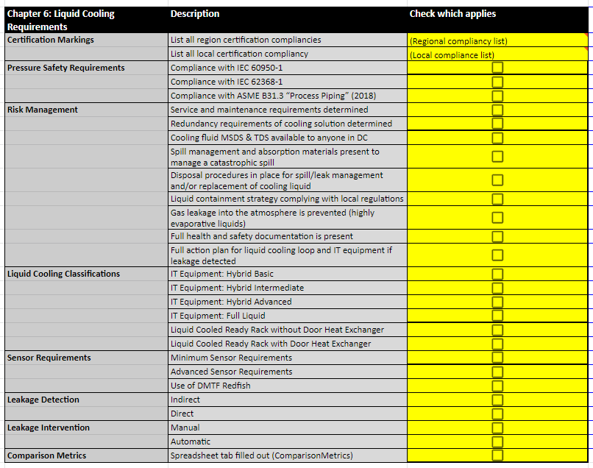
ACS Cold Plate Requirement - Process
TCS liquid cooling design specifications need to
adhere to the cold plate requirements
Process to determine compliancy
Cold Plate Requirement Checklist
Peer-reviewed by subject matter experts
When contribution meets the requirements ➔
proposed for approval by Incubation Committee
Incubation
Committee

Slide 8
ACS Cold Plate Requirements
Document Outline
Definitions
Component Selection & Parameters of Interest
Liquid Cooling Requirements
- Sensor Requirements
- Liquid Cooling Classification IT Equipment & Rack
- Leak Detection & Intervention Classification
Comparison Metrics

Slide 9
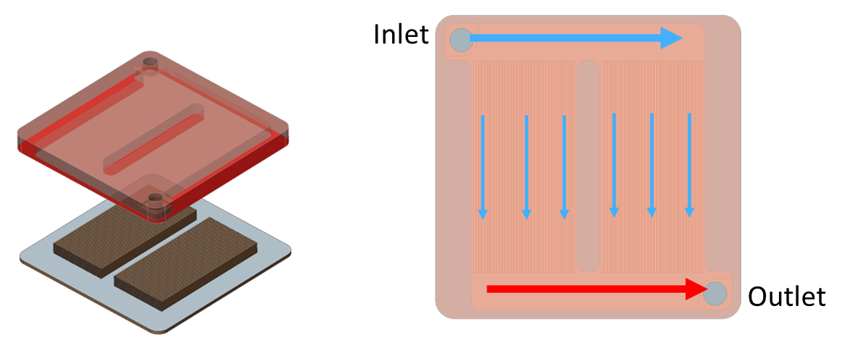
ACS Cold Plate TCS Components
Component Selection and Parameters of Importance:
Cooling Liquid
- Liquids
- Wetted Materials
- Filtering
- Commissioning and Maintenance
- Environmental Considerations
Cold Plates
Coolant Distribution Unit
Rack Manifold
Quick Disconnect Couplings
Pumps

Slide 10
ACS Cold Plate Requirement
Liquid Cooling Requirement
Certification Compliancy
- UL/FCC/CE etc
Pressure Safety Requirements
- IEC standards
- ASME
Risk Management
- Considerations, plans, and management

Slide 11
ACS Cold Plate Requirement
Liquid Cooling Requirement
Sensor Requirements
- Sensors to be considered within the system, chassis, rack, and CDU
- Minimum requirement:
- Tier 2 as defined by ASHRAE DCIM
- Advanced requirement:
- Tier 3 as defined by ASHRAE DCIM
DMTF Redfish
- Use the same IT telemetry that was adopted by DMTF Redfish in partnership
with ASHRAE TC9.9
Notes:
DCIM = Data Center Infrastructure Management

Slide 12
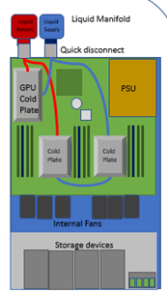
ACS Cold Plate Requirement
Liquid Cooling Requirements
Liquid Cooling Classifications
IT Equipment
Hybrid Basic - CPU/GPU cold plates
Hybrid Intermediate – Basic + DIMMs cold plates
Hybrid Advanced – Intermediate + additional cold plates
Full Liquid – Completely liquid cooled
Rack
• Liquid cooled ready rack without door heat exchanger
• Liquid cooled ready rack with door heat exchanger
Hybrid Basic

Slide 13
ACS Cold Plate Requirement
Liquid Cooling Requirements
Leakage Detection
Indirect: using existing pressure, flow rate, and temp sensors
Direct: using leak rope/cable detection sensors
Leakage Intervention
Manual: using manual intervention
Automatic: using automatic intervention

Slide 14
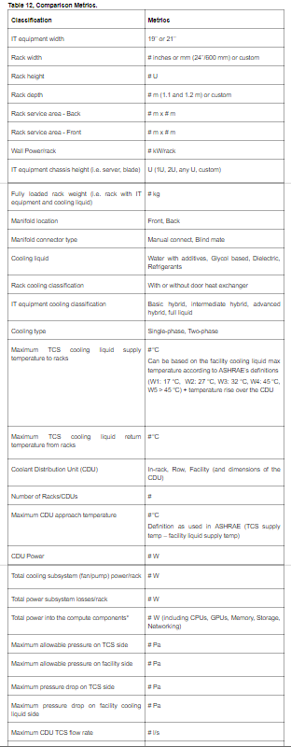
ACS Cold Plate Requirement
Comparison Metrics
Solution foot print
Solution density
Solution power
CDU option
Manifold location
Cooling liquid type
Cooling classification
Leak detection & intervention classification

Slide 15
ACS Cold Plate Requirement
Requirements Checklist – One Chapter Example
https://docs.google.com/spreadsheets/d/19LPCx5KRiFVMzvGwSadxjgW_nL4MJ4G0l_6WbN9vZy4/edit?usp=sharing

Slide 16
ACS ORV3 Blind Mate Liquid Cooling
Objective
Develop the interface specifications to standardize the form, fit, and function of the blind mate dripless quick connectors and manifolds so that they can interoperate between different suppliers for Open Rack V3

Slide 17
ACS ORV3 Blind Mate Liquid Cooling
Status
Kick-off meeting held Jan 2020
Areas of Focus:
Manifold Specification
Blind Mate Quick Connector Specification
Manual Couplings and Hoses Best Practices
Frame/IT Equipment Interfaces
System Level & Logistics Best Practices

Slide 18
ACS Cold Plate Summary
ACS Cold Plate Focus Areas
Cold Plate Requirements Document – approved
ORV3 Blind Mate Liquid Cooling – initiated
Next Focus Area
Leakage Detection and Intervention

Slide 19
Call to Action
How to get involved!
Join the Mailing Lists:
Advanced Cooling Solutions: https://ocp-all.groups.io/g/OCP-ACS
Cold Plate Work Stream: https://ocp-all.groups.io/g/OCP-ACS-Cold-Plate
Project Wiki:
https://www.opencompute.org/projects/acs-cold-plate-sub-project
https://www.opencompute.org/wiki/Rack_%26_Power/Advanced_Cooling_Solutions
Call Calendar:
Meeting every 2nd Wednesday of the Month at 8 am (PST)
https://www.opencompute.org/projects/rack-and-power
ADVANCED COOLING SOLUTIONS

