Slide 1
ORV3 AC Input Power Connector Updates
Jay Sandidge, Positronic
Will Stewart, Harting

Slide 2
How We Got Here
2018
Joint Development Agreement signed by development group
2019
Connection Interface Design Selected
2020-2022
Prototypes and Updates of Individual Designs
2023
Launch of Open Rack v3
This presentation will review:
The changes made to finalize the specification
Updates from the manufacturers
WS

Slide 3
Manufacturers’ Updates

Slide 4
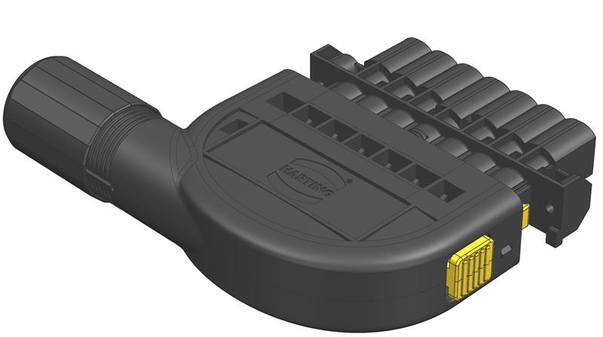
HARTING Development
Products Available
Timeline
Bulkhead connector
Plug – side connector
NEMA full cable assembly
UL full cable assembly
Samples available upon request
Final product available summer 2022
Safety Certifications
UL and TUV Pending
WS
Notes:
I think Safety Certifications would have more to do with formal UL, CSA, or TUV certification. These have more to do with conformance to aspects of safety certs, but that’s not the same as the entire connector and contact system being “UL certified” for example.

Slide 5
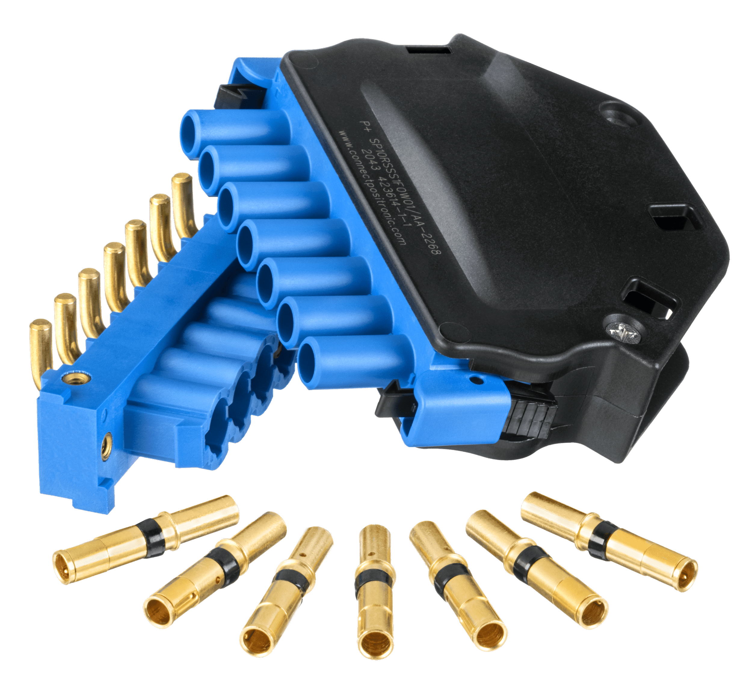
POSITRONIC Solution
Products Available
Timeline
Male PCB & crimp connector
Female AC whip connector
Crimp contacts
Hard tooled and in production
Shipping now for production power shelves
Safety Certifications
UL #E49351
TUV #SG PSB-IT-00193
JS

Slide 6
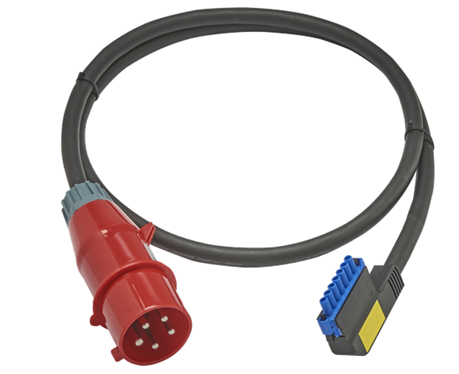
AMPHENOL CS Solution
Products Available
Timeline
Male PCB & crimp connector
Female AC whip connector
AC whip cable assembly
Crimp contacts
Hard tooled and in initial production
Shipping now
Safety Certifications
UL WIP, ETA May 2022
TUV WIP, ETA May 2022
JS

Slide 7
Specification Updates

Slide 8
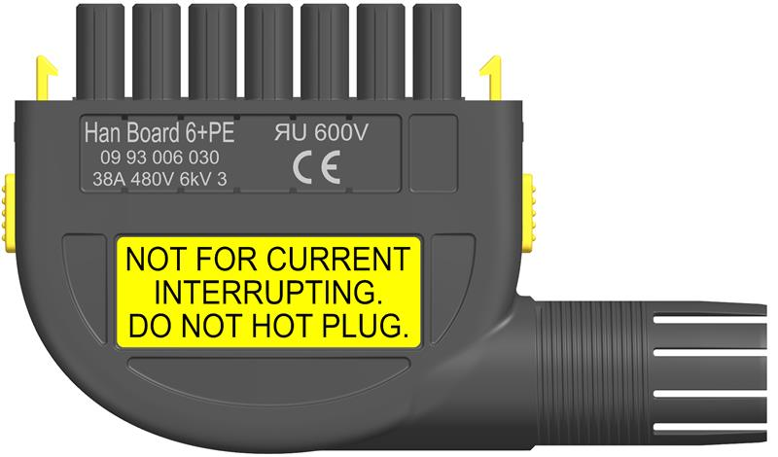
Disconnect Under Load
Original Wording:
Updates
Connector is not intended for current interrupting
Visual indicators applied to connector
Operators recommended to put processes in place to ensure connector is not disconnected under load
Space is limited
There is not enough room to oversize the contacts
“NOT FOR CURRENT INTERRUPTING” label is applied
WS

Slide 9
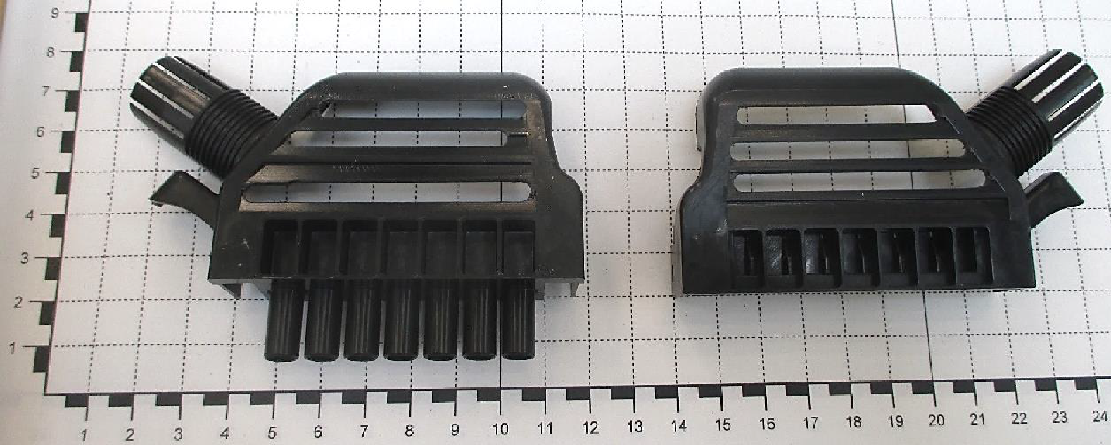
Crimp Contacts
Temperature Rise
ORV3 Application
Regulations require no temperature rise (above ambient) greater than 30ºC
Operating Amperage: 32A
Bulkhead Termination: PCB or Crimp
Cable wire size 10AWG/6mm²
Cable is too large to route through rack
Cable wire size 12AWG/4mm²
Temperature rise >30ºC
Even drastic solutions were not able to resolve the T-rise
Disclaimer: Holes were only applied for testing purposes. Final product does not have holes.
Solution
Crimp contacts with 8AWG wires
T-rise <30ºC with 10AWG/6mm² wires
Manufacturers recommend ensuring operating amperage and cable requirements are considered when choosing bulkhead
Space is limited
WS

Slide 10
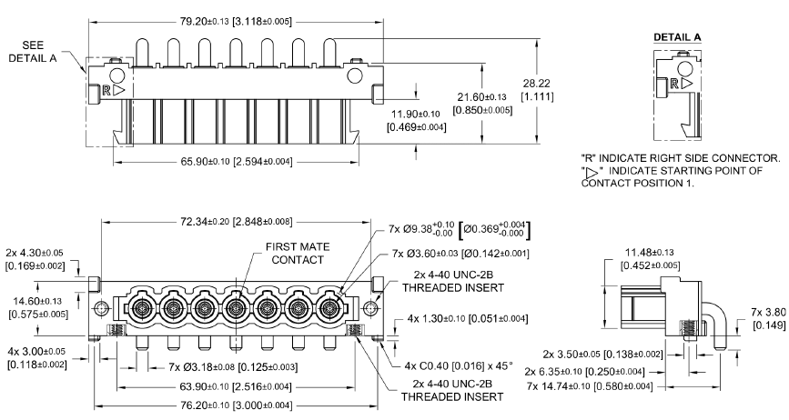
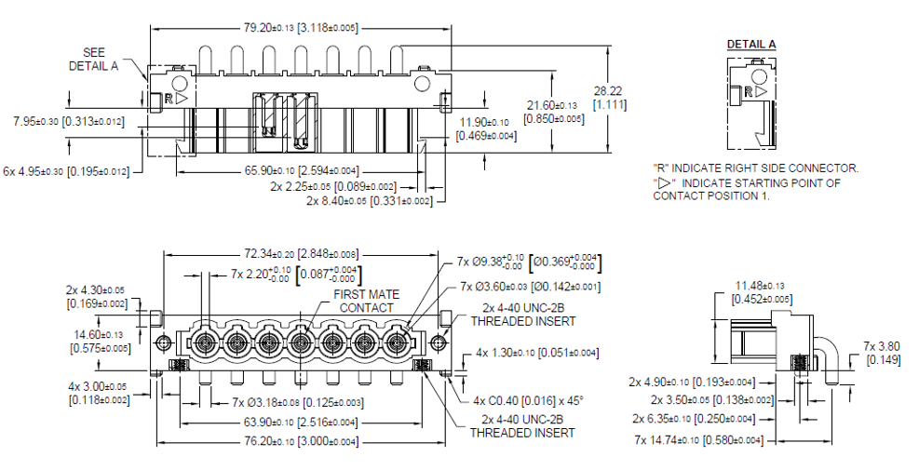
Male Right Angle PCB ADDED DIMENSIONS
JS

Slide 11
Male Right Angle PCB ADDED DIMENSIONS
JS

Slide 12
Wipe Length
Added the following note:
Recommended wipe length for 1st mate is 7mm and standard is 4mm.
JS

Slide 13
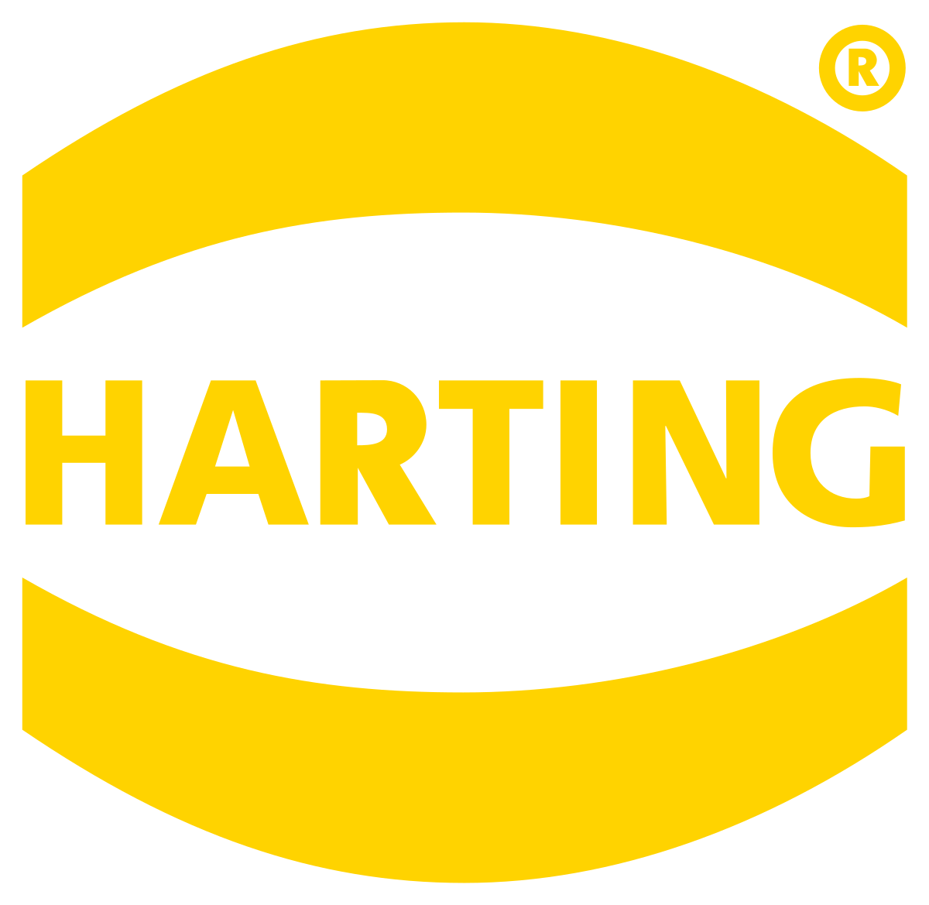
Contact Us
Will Stewart
Data Center Segment Manager
Harting of North America
william.stewart@harting.com
+1 (224) 762-0527
Jay Sandidge
Director of Marketing
Positronic Amphenol
jsandidge@connectpositronic.com
+1 (417) 343-4848

